Slide 1
Innovation patterns of Innosuisse applicants
«Evaluation of the Innosuisse survey 2021»
Study commissoned by Innosuisse
Hulfeld F., Spescha A., Wörter, M.
Zurich, 27.01.2023

Slide 2
Introduction

Slide 3
Initial Position
Second implementation of the survey after pilot project in 2019
  Adapted questionnaire since last implementation
    New questions (labeled new below)
    More extensive questions in other areas (labeled ext below)
    Dropped questions in other areas (support mechanisms and motives for public innovation support)
    Present study focuses on innovation patterns of Innosuisse firms and does not assess the impact of Innosuisse funding
        Comparison of Innosuisse clientele with other R&D active Swiss companies follows in the next survey wave 2023
Topics of the survey
  Innovation activities
    Development of innovation activities
    Risk of innovation activities (ext)
    Utility of innovation support
  Innovation promotion instruments (new)
  International innovation collaboration (new)
  Novelty and disruption of innovations (new)
  Impact of the COVID-19 pandemic on innovation activities (new)
  Sustainable Development Goals (SDG) (new)
  Innovation and turnover shares of funded firms (new)
Unless stated otherwise, the results refer to the 2021 survey

Slide 4
Goals of the Study
Monitoring of applicants to Innosuisse’s primary funding tools (“Innovation projects” / “Innovation cheques”) to track the evolution of their innovation patterns: characteristics, activities, risks and needs
Gain a more fundamental understanding of the reach, effectiveness and evolution of Innosuisse’s innovation support and gather more insight into topics of special interest for Innosuisse
Input to evidence-based strategic optimization of funding instruments

Slide 5
Takeaways

Slide 6
Takeaways
Innovation activities keep increasing
  Slightly slower growth in period 2018 to 2020 (55.5%) compared to 2016 to 2018 (62.9%)
  Expected increase in future innovation activities despite COVID-19 pandemic:
  Higher positive expectations for next three years (60.7%), but expectations are lower than three years ago (69.1%)
  Startups have the strongest increase
Innovation risks are more pronounced for market implementation than feasibility
  42% have high or very high market implementation risks
  32% have high or very high feasibility risks
  Startups and SMEs have higher market implementation risks
  Rejected applicants seeking international funding struggle significantly more with both innovation risks
  Innovation cheques and projects have identical innovation risks
The innovation support from Innosuisse is highly useful
  71% indicate a high or very high utility in 2021; 78% indicate a high or very high utility in 2019
  Rejected applicants drive the slight reduction since 2019
  Innovation cheques and projects are equally useful
  Even rejected proposals see the innovation support as useful

Slide 7
Takeaways
Other innovation funding instruments are also well known
  Over 60% are aware of Mentoring and Start-up Coaching
  Around 50% are aware of Swiss Innovation Power (COVID-19), EUREKA and Eurostars
International innovation collaboration is important
  51% see international companies as highly or very highly relevant collaboration partners
  40% see international research organizations as highly or very highly relevant collaboration partners
  Key reasons for international innovation collaboration are product innovations for the international market, entry to foreign markets, and strategic business relations
  Startups have the highest appreciation for international collaboration partners and especially for international companies
  Startups mostly seek financing of innovation activities, research partnerships, entry to foreign markets, strategic business relations
  Europe (93%) and especially border countries (Germany 75%, France 25%, Austria 17%) as well as the US (38%) and China (13%) are relevant
Innovations are more often radical than incremental
  37% say their innovations are radical while only 25% say they are incremental
  Startups have tendency towards more radical innovations
  SMEs have more radical innovations opposed to large companies
  Companies funded by innovation cheques and projects have equal degree of radicality

Slide 8
Takeaways
Most innovations show some disruption, but to a limited degree
  58% see their innovations as middle or weakly disruptive, 29% as strongly or very strongly disruptive
  Radical innovations are more disruptive than incremental innovations but no one-to-one relationship
  SMEs are more disruptive than large companies
  Startups are more disruptive than established companies
  The creation of world market novelties is the most common disruptive effect
COVID-19 pandemic (first two waves) influenced innovation activities
  27% were strongly or very strongly influenced by the pandemic however 49% felt only a weak or no impact
  Startups and companies with international innovation funding felt the strongest impact
  Digitization and social innovations became more important
  The strategic importance of innovations increased and business models were re-invented
  Collaborations with companies and research institutions decreased
  Innovation investments were negatively affected by the pandemic

Slide 9
Takeaways
Innovation activities of Innosuisse clientele contribute frequently to the UN's Sustainable Development Goals
    Biggest contributions are within “Industry, Innovation and Infrastructure”, “Good Health and Well-Being” and “Climate Action“
  51% have a high contribution to at least one SDG and 20% have only a minor or no contribution to all SDGs
  Most contributions are linked to developed countries
  Startups and large companies contribute the most
  Multiple contributions are common
In 2020, the Innosuisse clientele had a higher turnover share from product innovations and especially market novelties
  Companies with approved projects report an average turnover share from product innovations of 51.7%
    29.9% from firm novelties, 21.8% from market novelties
  Companies that never applied for Innosuisse funding since 2016 but are R&D-active, report an average turnover share from product innovations of 30.4%
    24.7% from firm novelties, 5.7% from market novelties
  Differences do not allow any causal interpretation (reflect both selection effects and impact of funding)

Slide 10
Sample and Response

Slide 11
Sample composition and response rates
Total Sample Size: 3595
The total sample size is 3595 and comprises applicants to the two primary Innosuisse funding instruments (“Innovation projects” and “Innovation cheques”) since 2016
  2106 observations have an application after the last implementation of the Innosuisse survey in 2019
  1489 observations only have applications prior to that
Response rates are substantially higher than in pilot project
  29.4% (vs. 23.4% in 2019) answer Innosuisse survey
  19.0% (vs 11.4% in 2019) answer both Innosuisse survey and KOF Innovation Survey
Everyone that answered the KOF Innovation Survey also answered the Innosuisse survey
  explained by the merger of the surveys and precedence of Innosuisse survey
Non-responders
2539 (70.6%)
Responders to the
Innosuisse survey:
1056 (29.4%)
Responders to the
KOF Innovation Survey:
682 (19.0%)
# of cases
response rate
Notes:
The 2106 new funding applicants are those that can be linked to newer funding applications
The 1491 old funding applicants are those that can be linked to older funding applications, if they cannot be linked to newer funding application (which are therefore assumed as not having a newer application)

Slide 12
Development of innovation activities

Slide 13
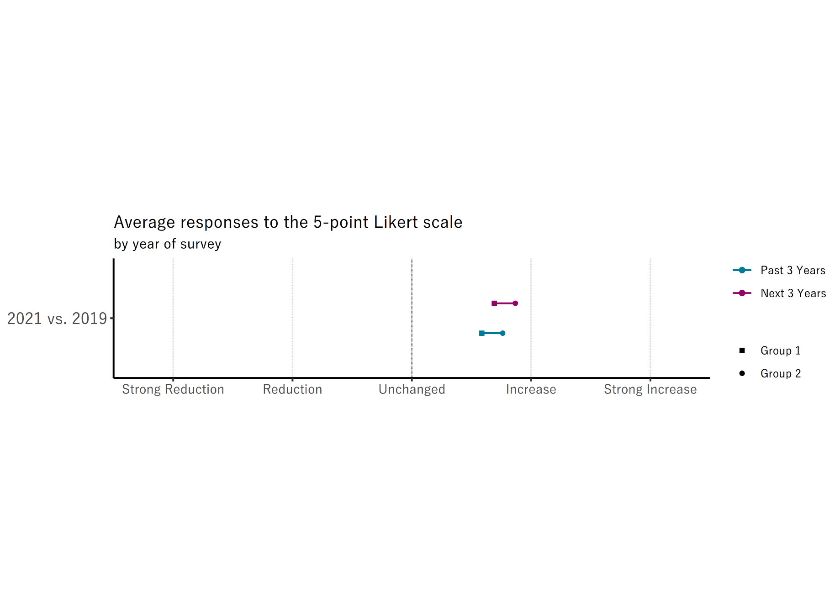

Development of innovation activities
Questions: How did the innovation activities in your company develop in the last 3 years?
How will the innovation activities in your company develop in the next 3 years?
Detailed Information
Group 1
Group 2
Key findings:
Past and expected future developments of innovation activities are positive
Expectations exceed past developments
Reduction in past and expected future innovation activities for 2021
Large discrepancy between 2019 expected future and 2021 realized past developments
Notes:
The higher averages for expected future development opposed to realized past developments stems primarily from higher percentages in strong increase and lower percentages in unchanged
The higher averages for the 2019 survey opposed to the 2021 survey stems primarily from higher percentages in strong increase and lower percentages in unchanged
Key findings:
Past and expected future developments of innovation activities are positive
Expectations exceed past developments
Reduction in past and expected future innovation activities for 2021
Differences are statistically significant (see appendix)
Large discrepancy between 2019 expected future and 2021 realized past developments
In 2019, companies were much more confident in the next three years than what happened
Nevertheless, the expectations of the next three years still exceed the development between 2018-2020, but fall behind the development between 2016-2018

Slide 14
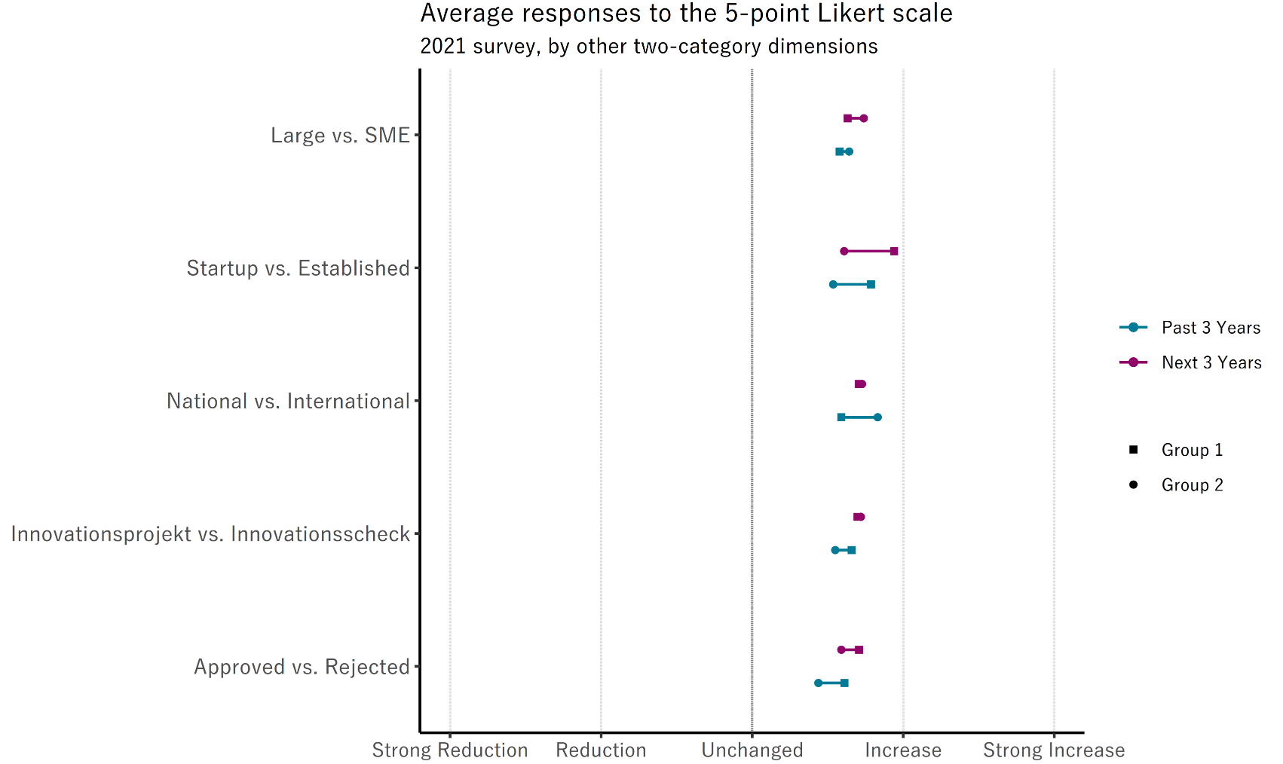
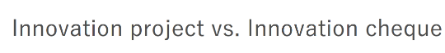
Development of innovation activities
Questions: How did the innovation activities in your company develop in the last 3 years?
How will the innovation activities in your company develop in the next 3 years?
Key findings:
The average response is always positive irrespective of the subgroup
Most groups are not significantly different in their assessment of the past and expected future developments
Companies with approved proposals had better developments in the last 3 years opposed to those with rejected proposals
Companies with international funding had a better past development than those with national funding
Startups have both better past and expected future developments than established companies
Rejected
Approved
Notes:
As the graph reads, these comparisons are entirely based on the 2021 survey. Although it might be feasible to do them for the pilot survey in 2019, I don’t expect much to be gained and assume that there would simply be a right shift of those averages while the discrepancies between the two groups would remain mostly persistent.
“National” vs “International” refers to companies that received the described funding. Companies can apply for collaboration projects with national partners or with international partners and this comparison excludes firms that applied for one of those but got rejected. Furthermore, the group “International” can also include companies that collaborated with international and national partners while the group “National” strictly excludes international collaborations.
The same logic holds true for “Innovation projects” vs. “Innovation cheques”. Only the companies that got funded by one of those two means are compared. We restrict the comparison to companies that were funded by one of the mentioned channels and exclude those that applied for them but did never receive that funding. In our opinion that is the more meaningful comparison although we caution to interpret these differences as causal (i.e. that the funding is responsible for the different developments of the innovation activities.)
It is important to keep in mind that:
the companies with approved proposals include all applicants since 2016 that had at least one successful proposal and that
the companies with rejected proposals include all those that had all their applications rejected since 2016, not necessarily before that

Slide 15
Risk of innovation activities

Slide 16
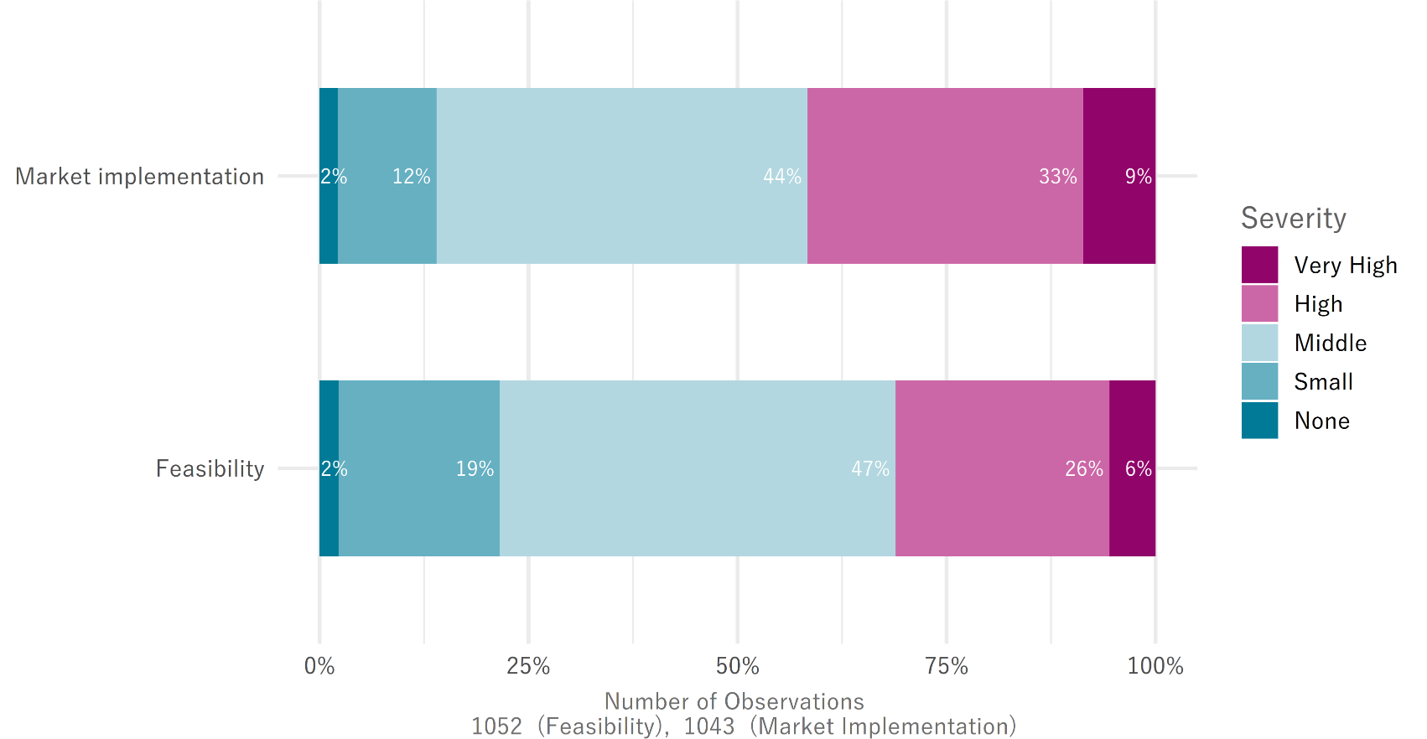
Risk of innovation activities
Questions: How high are the R&D and innovation risks of your company related to feasibility?
How high are the R&D and innovation risks of your company related to market implementation?
Innovation risks exist for almost everyone
  Only 2% see no risks in the feasibility or market implementation of innovations
Market implementation is a more prevalent risk
  42% of respondents have high or very high market implementation risks
  32% of respondents indicate high or very high feasibility risks
Most companies assess both innovation risks as middle
  44% of respondents indicate that for market implementation risks
  47% of respondents indicate that for feasibility risks
Notes:
Higher feasibility risks referring to value 4 and 5
Looks like that companies apply for innosuisse support related to risk of market implementation (of new products/services).

Slide 17
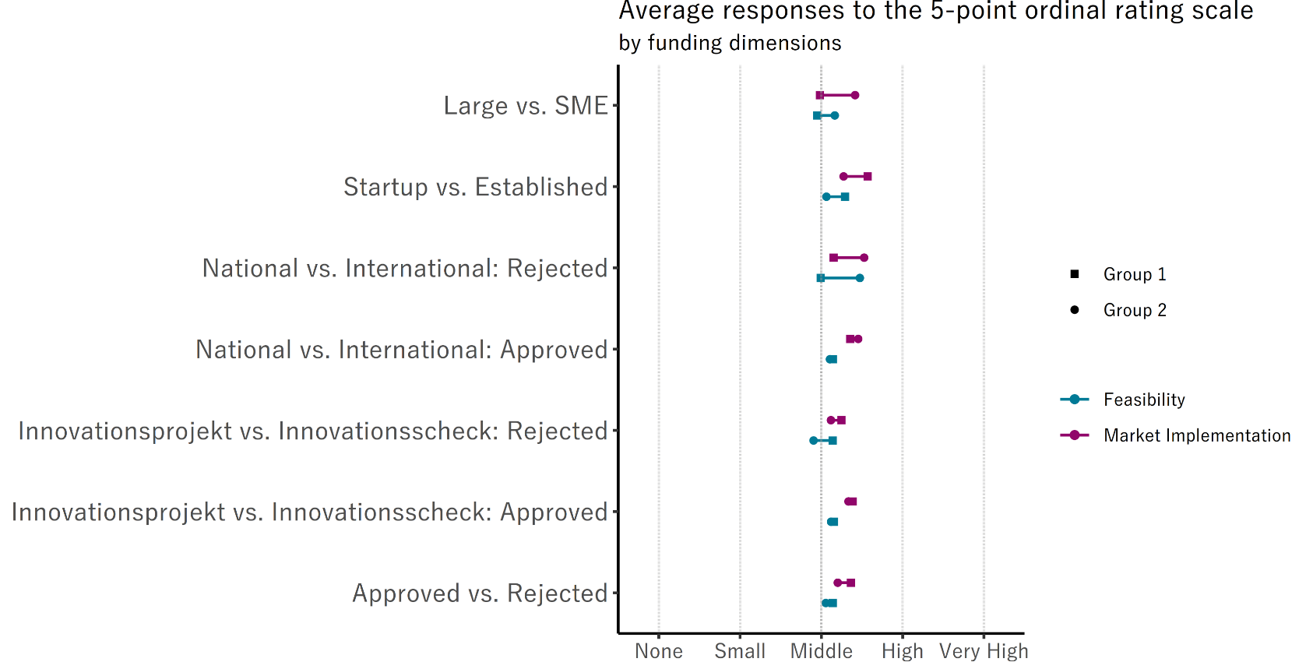

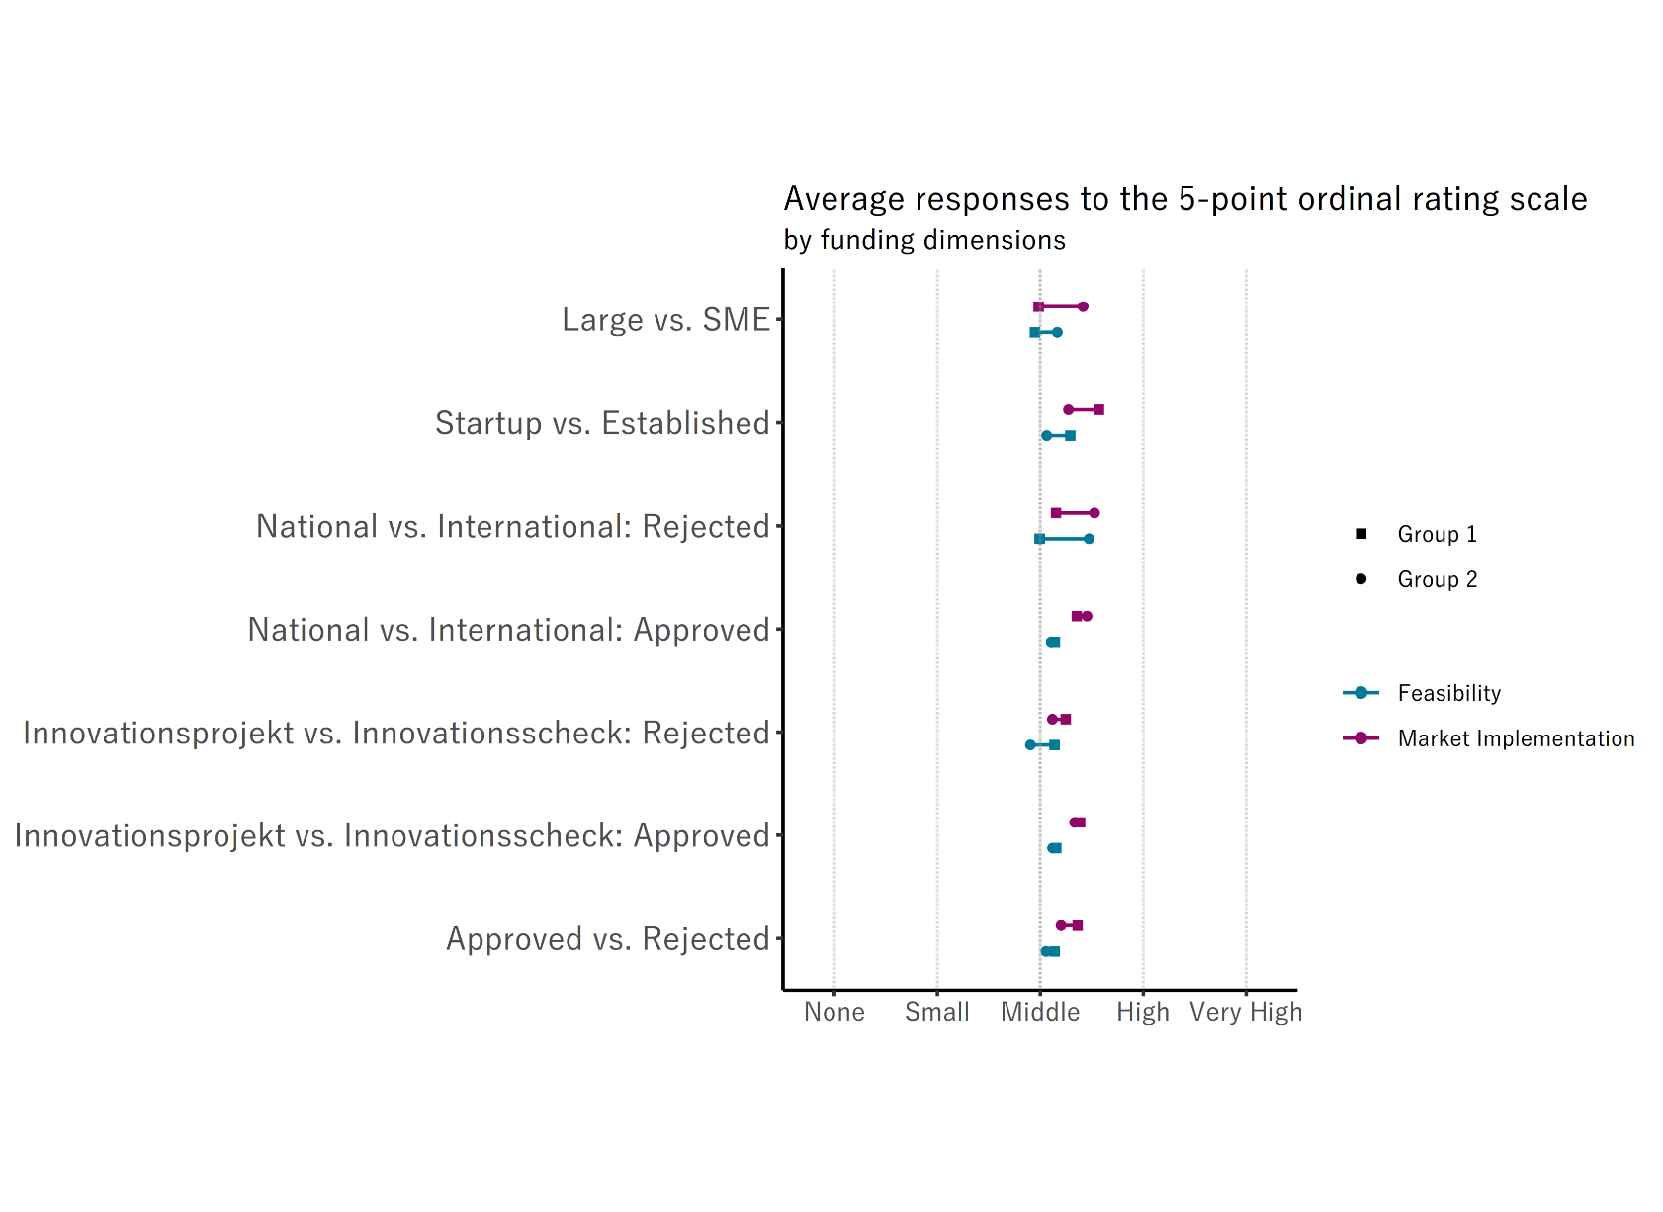
Risk of innovation activities
Questions: How high are the R&D and innovation risks of your company related to feasibility?
How high are the R&D and innovation risks of your company related to market implementation?
Innovation risks are similar across all funding dimensions
  Those that are funded (“Approved”) have similar risks irrespective of whether that funding came from projects or cheques or from national or international collaborations
  Companies that don’t get any funding (“Rejected”) have different risks depending on what they applied for
Innovation risks are different across firm characteristics
  Startups have higher innovation risks than established companies
  SMEs have higher innovation risks than large companies
Notes:
The funding dimensions include
if a proposal for funding was accepted (“Approved vs. Rejected”)
If the proposal was for project funding or cheque funding (“Innovation project vs. Innovation cheque”)
If the proposal was for national or international funding (“National vs. International”)
where the latter two are broken down by whether the proposal was accepted or rejected
There is no positive risk selection apparent (across funding dimensions)
Companies that receive funding have slightly higher market implementation risks and feasibility risks, but those differences are very small and not statistically significant.
This is contrary to the results of the pilot survey in 2019 where a positive risk selection was apparent
This discrepancy might occur due to the mitigating effect of the received innovation funding and support since the category “Approved” includes all companies that received innovation support since 2016.
Companies that don’t get any funding (“Rejected”) have different risks depending on what they applied for
Companies with international rejections have higher risks than companies with national rejections, especially feasibility risks
Companies with project rejections have higher feasibility risks than companies with cheque rejections, but not statistically significant at a 5% level

Slide 18
Utility of innovation support

Slide 19
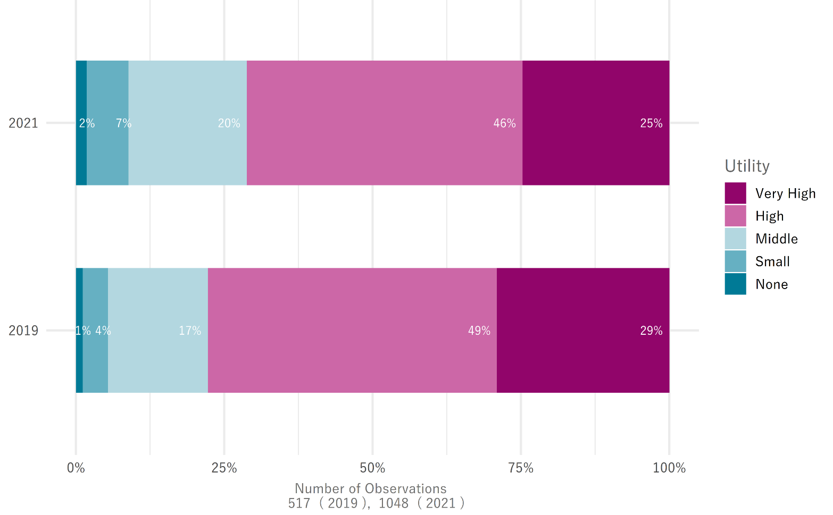
Utility of innovation support
Question: How would you rate the overall utility of Innosuisse's innovation funding?
Key findings:
Innosuisse’s innovation support has a high utility
  In both surveys, over 70% of all applicants assess the utility as high or very high
The perceived utility has slightly decreased between 2019 and 2021
  In 2019, the share of companies that indicate a high or very high utility was 7 percentage points higher than in 2021
  In 2021, those 7 percentage points spread evenly to higher percentages in middle and small utility, but not to no utility
  The difference is statistically significant at a 5% level
Notes:
Project vs Cheque / International vs National again only apply to approved applications

Slide 20
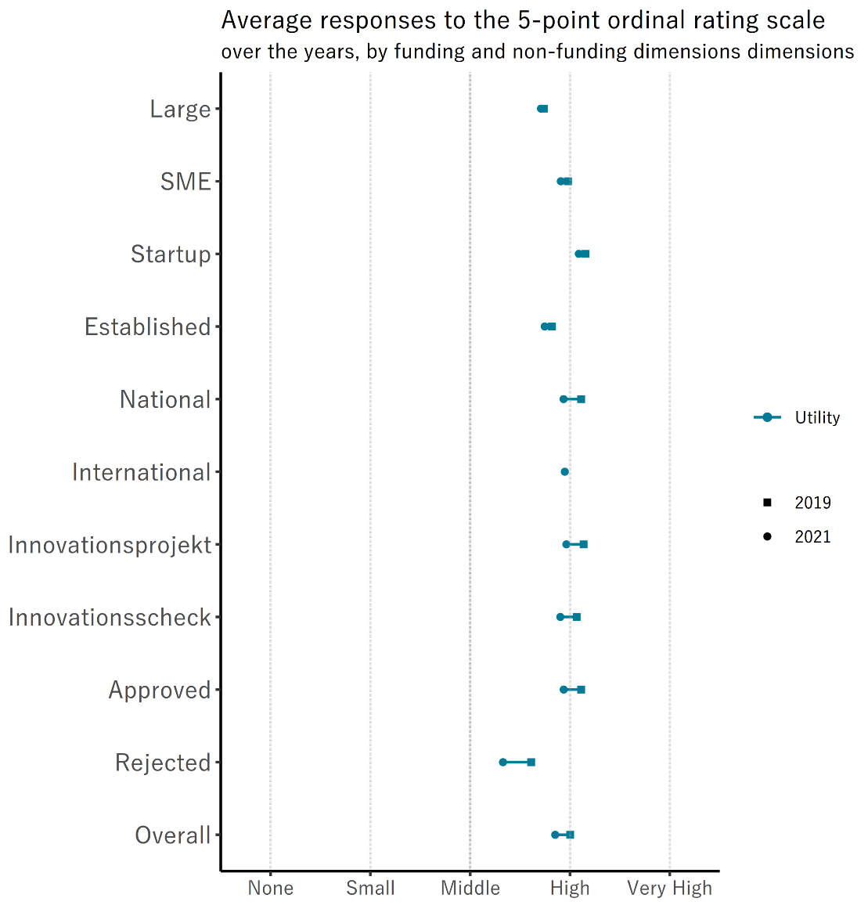


Utility of innovation support
Question: How would you rate the overall utility of Innosuisse's innovation funding?
Key findings:
The overall decrease in utility between 2021 and 2019 is small but statistically significant
  The average utility is still high for more than 70% of companies
  Rejected applicants are mainly responsible for the decrease in utility
  Approved applicants also show a very small reduction
  For the other funding dimensions, we also see a small reduction
  Within groups based on firm characteristics the utility assessment is stable over time
Some groups assess a different utility to the innovation support
  Approved applicants have a higher utility than rejected applicants
  Startups have a higher utility than established companies
  SMEs have a slightly higher utility than large companies
Some groups assess a similar utility to the innovation support
  Companies funded by cheques and funded projects
  Companies with national funding and those with international funding
Notes:
Project vs Cheque / International vs National again only apply to approved applications
Description of the graph:
Now we compare years across groups
2019 is the square [■]
2021 is the point [●]
We have no information on international applications prior to 2019, so that data point is missing by design

Slide 21
Innovation Promotion Instruments

Slide 22
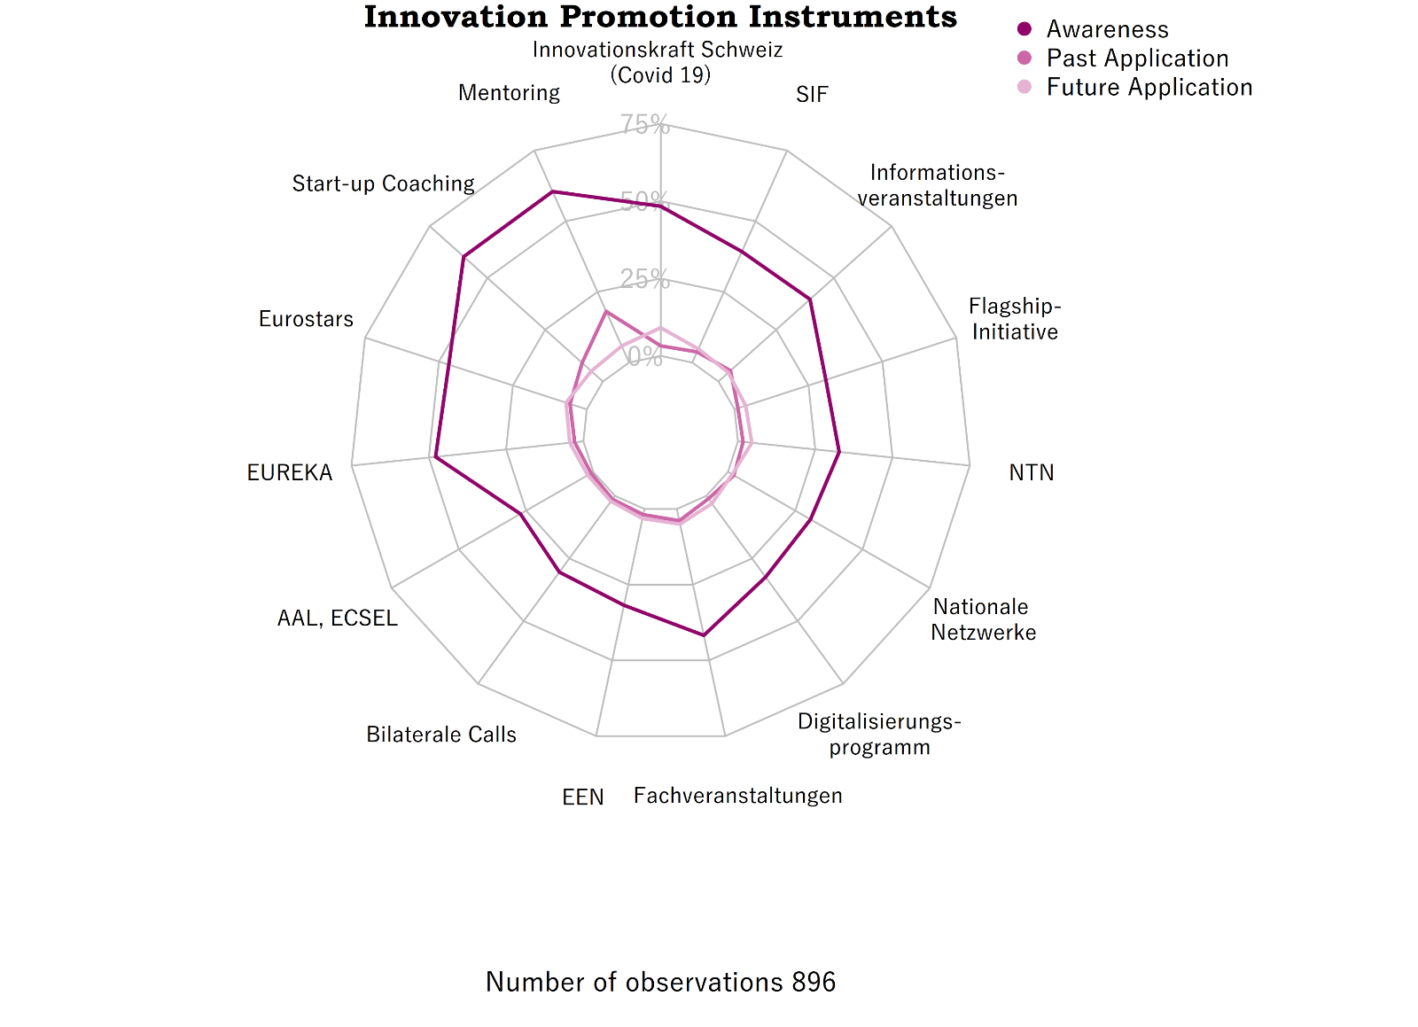
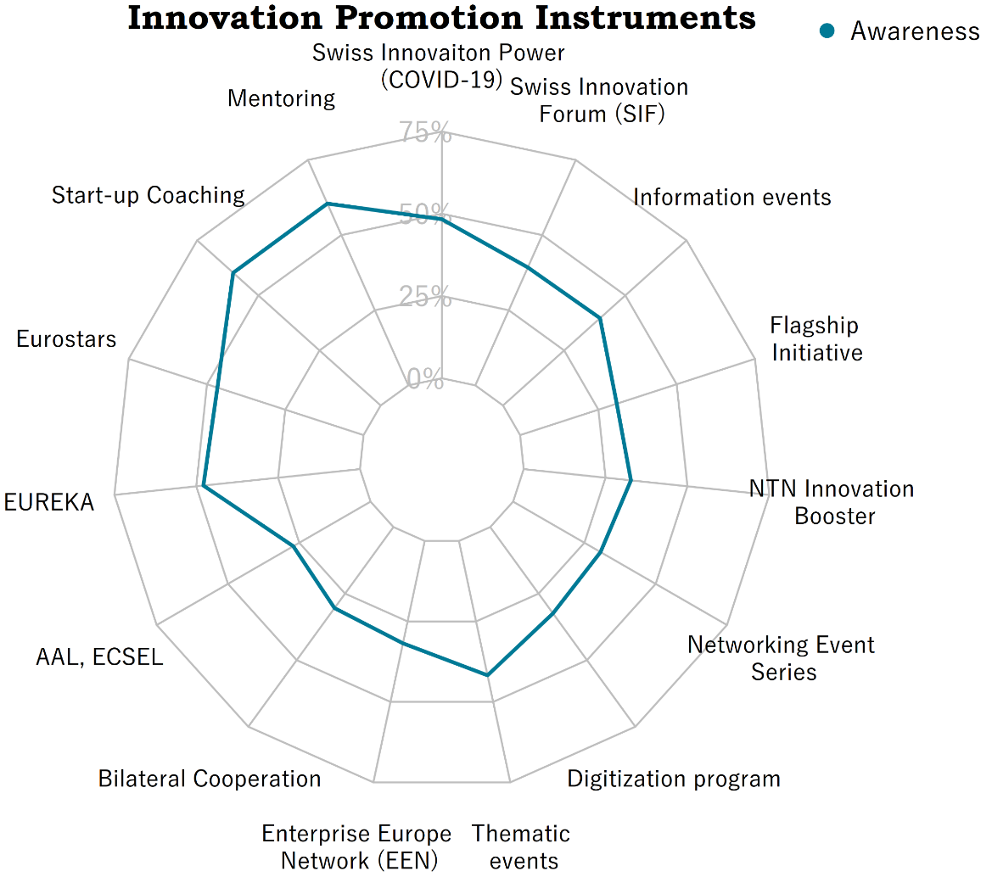
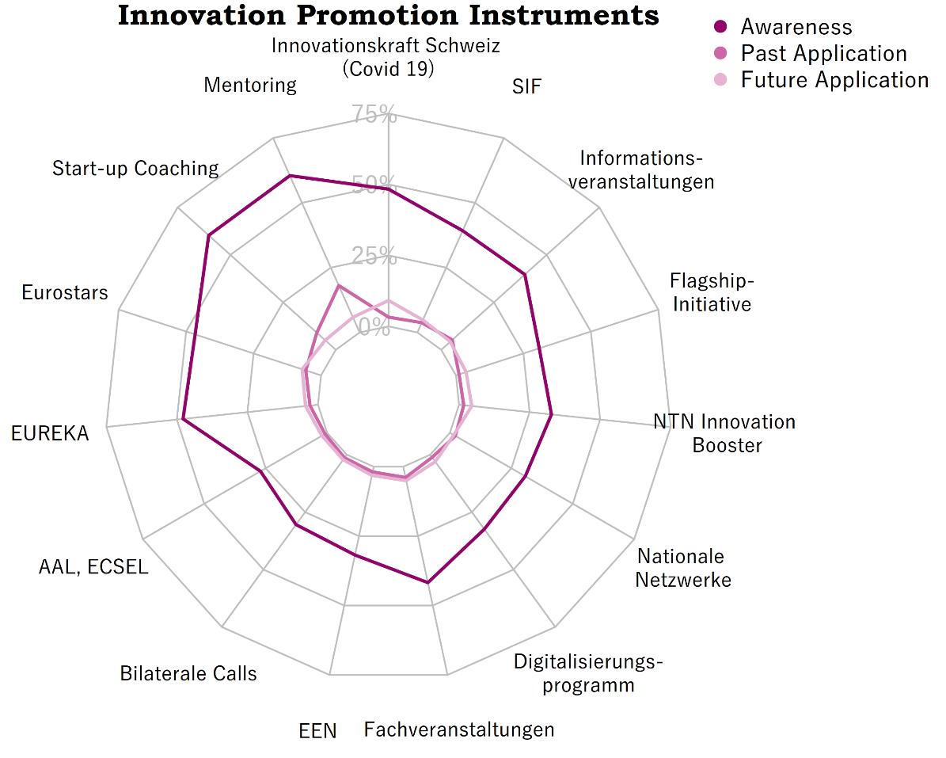

Innovation Promotion Instruments
Questions: Is your company aware of the following Innosuisse instruments or events?
Key findings:
Mentoring and Start-up Coaching are best known promotion instruments
  Over 60% of the survey participants are aware of those instruments
  The sample only contains firms that specifically applied for one of the Innosuisse’s two main funding mechanism (“Innovation cheques” and “Innovation projects”)
Swiss Innovation Power (COVID-19), EUREKA and Eurostars are also well known
  Around 50% are aware of these funding instruments
The utility assessment was answered so poorly that we only show evidence in the appendix that we refrain from interpreting since the uncertainty of the results is simply too big
Notes:
This graph must be treated cautiously. The matrix (6 x 17 = 102 entries) was too big a workload for most survey participants is was answered very poorly. The resulting graph is therefore based on heavily corrected data. The data correction was done in 5 steps:
Rule 1: Logical fallacy
for each of the 17 innovation promotion instruments individually:
if the respondent
applied for OR
assessed the utility of OR
will apply for
the instrument, he must also know it
Rule 2: Recorrecting misses
if at least one of the 102 items was chequed (questions were constructed as textboxes [either 1 or NA])
the remaining ones are set to 0
Rule 3: Jointly exhaustive utilities
for each of the 17 innovation promotion instruments individually:
if all three utility levels (none, middle, high) are 0
they are set to NA
Rule 4: Mutually exclusive utilties
for each of the 17 innovation promotion instruments individually:
if multiple utility levels are 1
the highest utility level is set to 1 and the rest to 0
Rule 5: Unreliable respondents
if a respondent applied for Innovation cheques or Innovationsprojekte (known information to us) but fails to indicate that he knows the instrument he applied for,
the entire matrix is set to NA
For this graph steps i, ii and v are relevant
The sample only contains firms that specifically applied for one of the Innosuisse’s two main funding mechanism (“Innovation cheques” and “Innovation projects”)
Therefore, the two prime funding instruments are even better known but are left out of this graph as that statement is a truism
The results don’t mirror the popularity of the other funding instrument in the whole economy.

Slide 23
International innovation collaboration

Slide 24
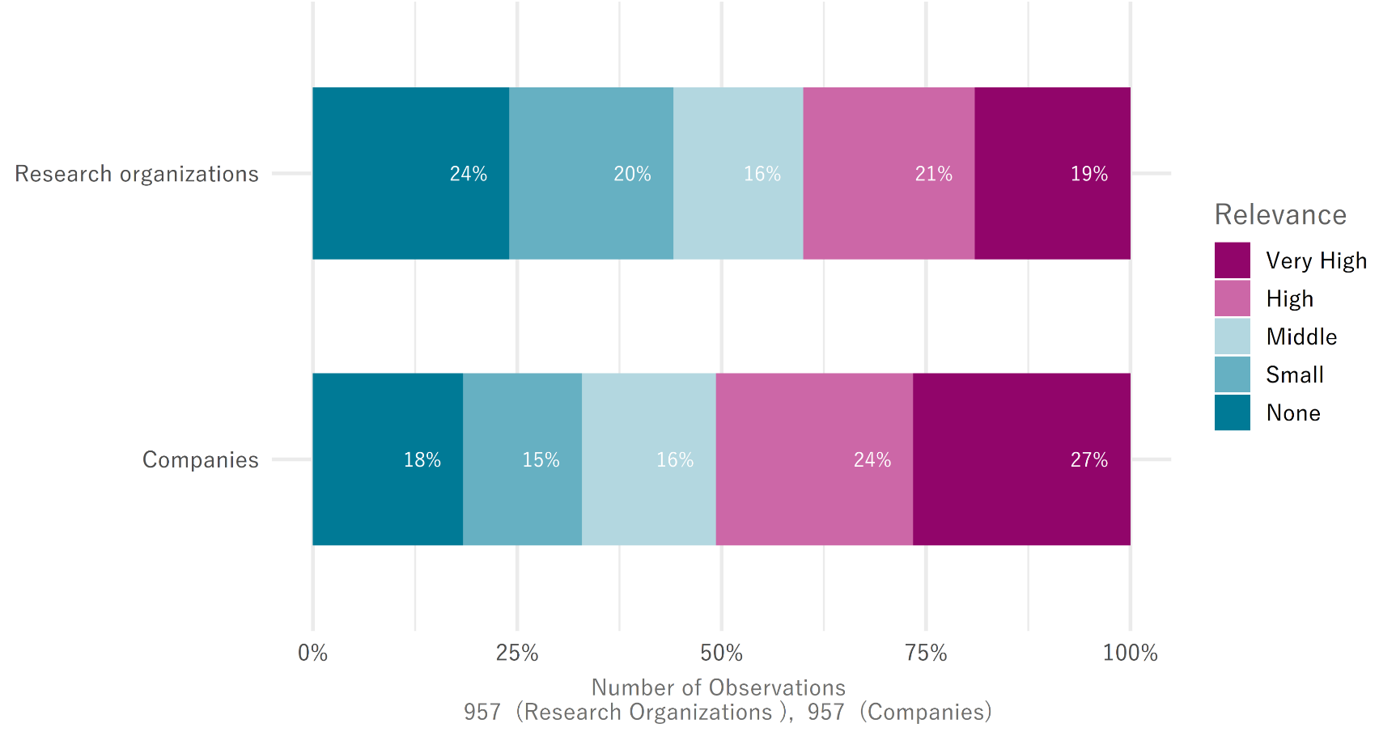
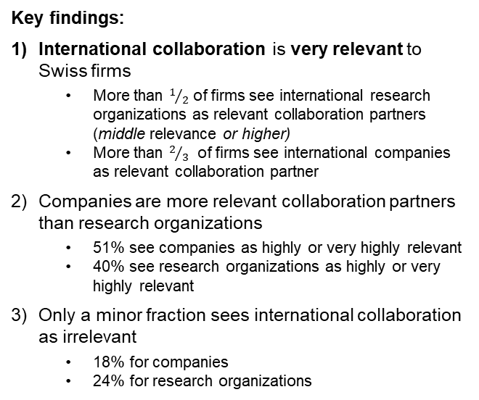
International innovation collaboration
Questions: How relevant is innovation collaboration with foreign companies for your company?
How relevant is innovation collaboration with foreign research organizations for your company?
Key findings:
International collaboration is very relevant to Swiss firms
  More than $1/2$ of firms see international research organizations as relevant collaboration partners (middle relevance or higher)
  More than $2/3$ of firms see international companies as relevant collaboration partner
Companies are more relevant collaboration partners than research organizations
  51% see companies as highly or very highly relevant
  40% see research organizations as highly or very highly relevant
Only a minor fraction sees international collaboration as irrelevant
  18% for companies
  24% for research organizations

Slide 25
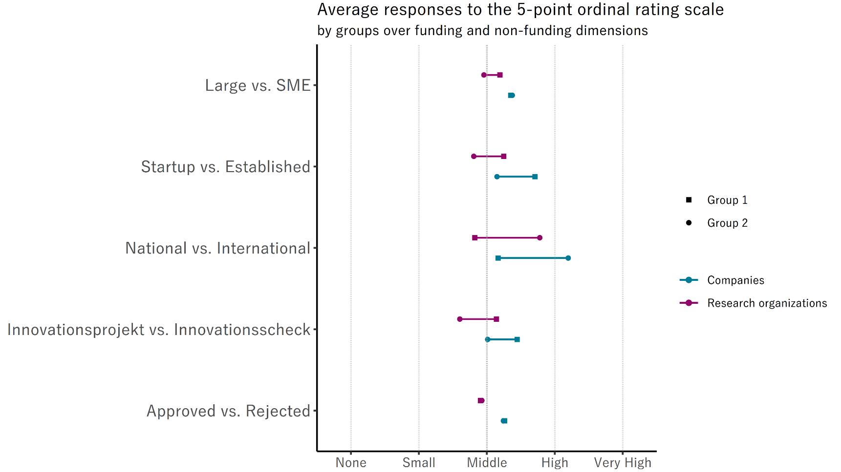
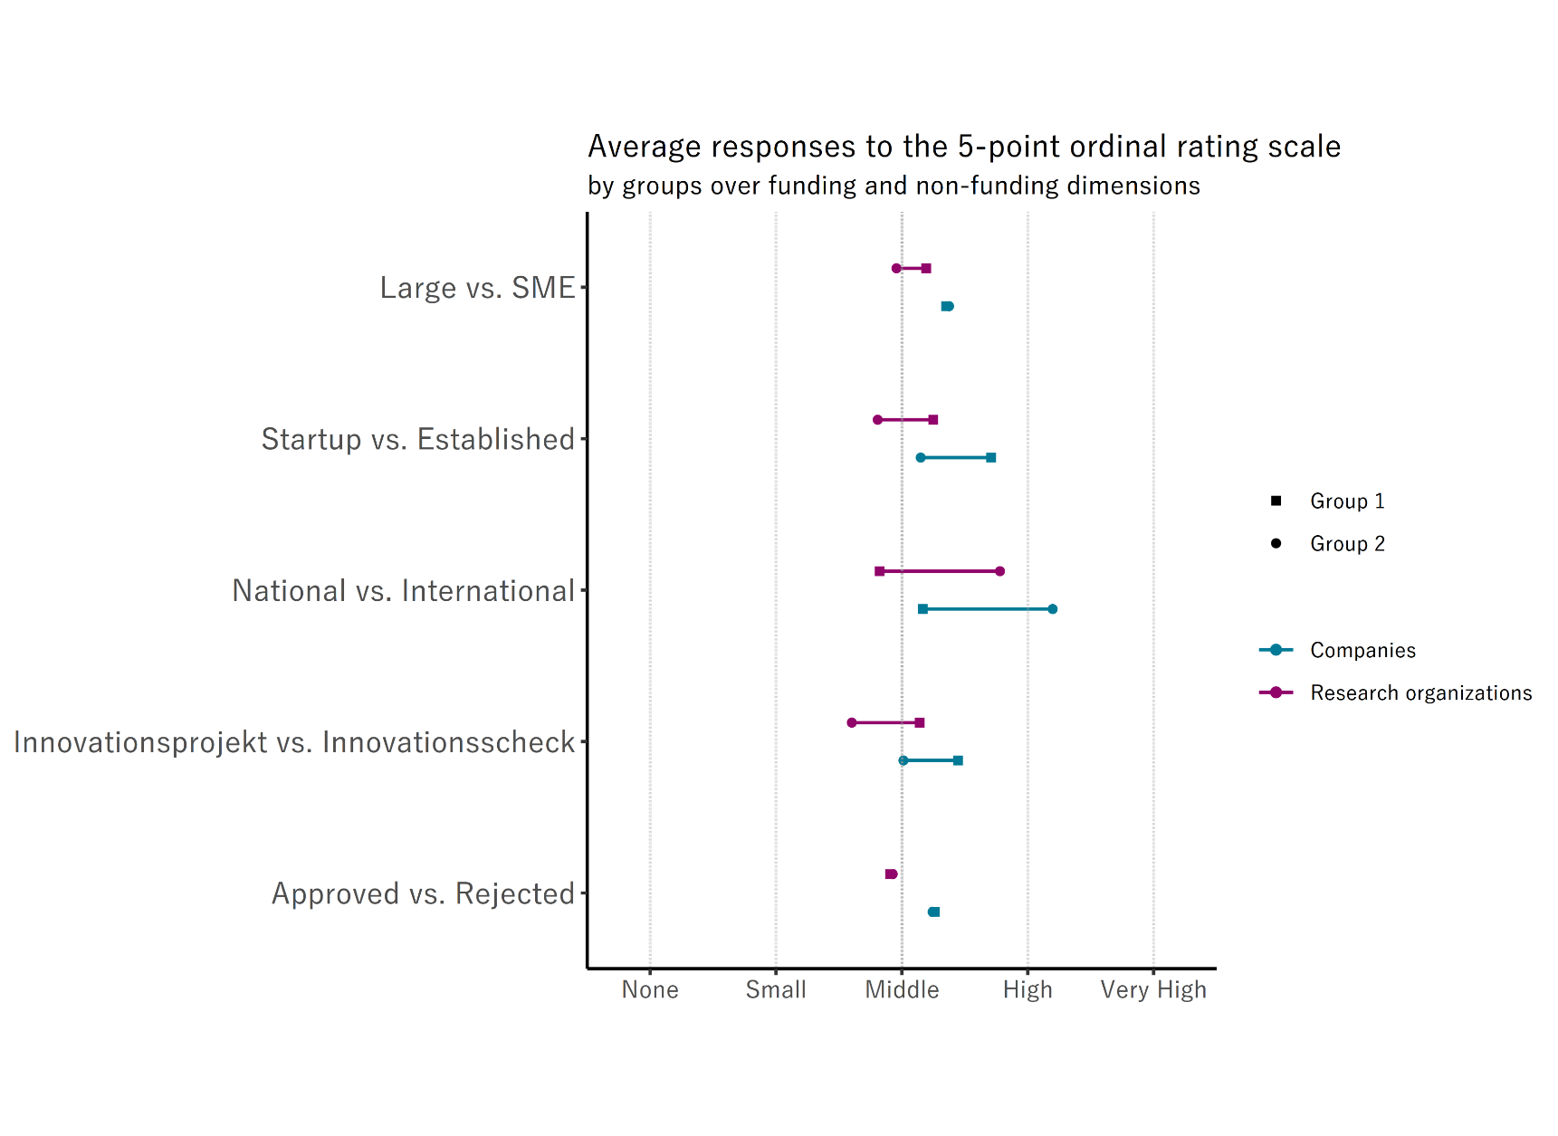
International innovation collaboration
Questions: How relevant is innovation collaboration with foreign companies for your company?
How relevant is innovation collaboration with foreign research organizations for your company?
Key findings:
Companies are more relevant international collaboration partner, irrespective of the dimension or group
Approval and firm size have no statistically significant influence on the perceived relevance of international partners
Project applicants see international partners as more relevant than cheque applicants
Applicants for international collaborations see international partners as more relevant
Startups see international collaborations as more relevant than established firms
Notes:
Here, «International vs National» and «Innovation project vs Innovation cheques» again comprise all companies that applied for such a funding not just those that were funded by one of those means

Slide 26
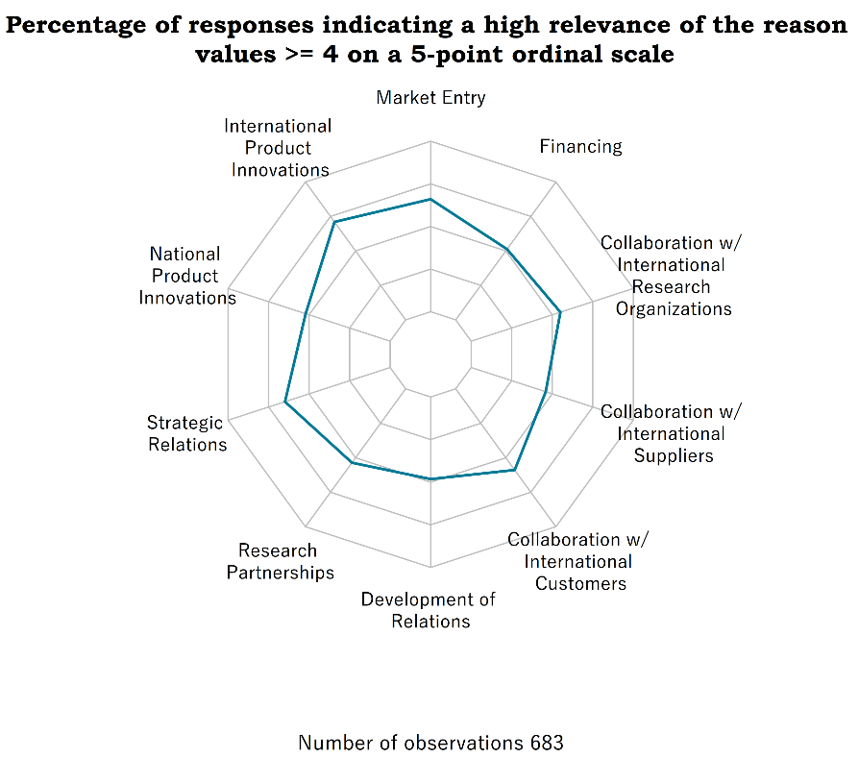
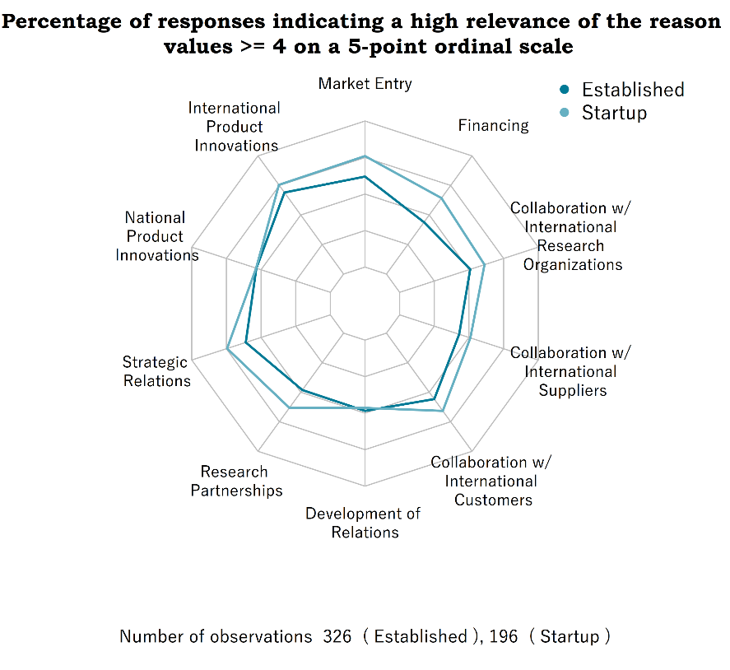
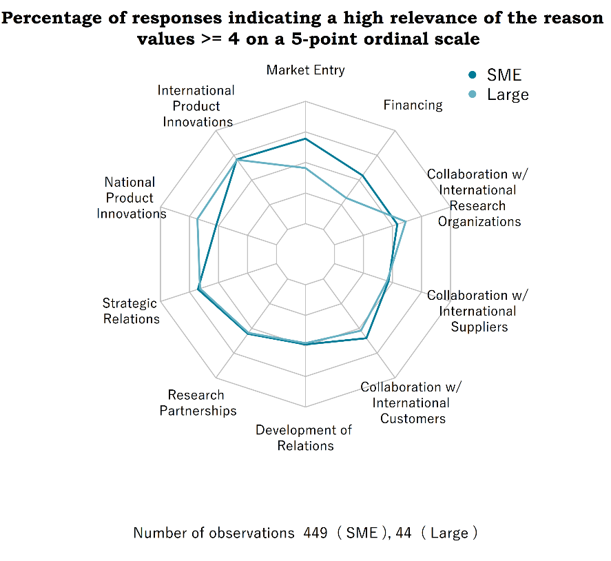
International innovation collaboration
Questions: If international innovation collaboration is relevant for your company, for what reasons?
Key findings:
Overall, high relevance of all motives
  For all reasons, between 46% and 71% of all companies that see international collaborations as important see the specific reason as relevant
‘Product innovations for the international market’, ‘Entry to foreign markets’, and ‘Strategic business relations’ are the most relevant motives
Startups generally see a higher relevance behind most reasons
  Especially true for ‘Strategic business relations’, ‘New research partnerships’, and especially ‘Financing of innovation activities’
SMEs and large companies see the relevance of reasons similarly
  SMEs assign a higher relevance to ‘Entry to foreign markets’ and ‘Financing of innovation activities’
  Large companies assign a higher relevance to ‘Product innovations for the national market’
Notes:
The percentages apply to companies that indicate a medium to high relevance of at least one international collaboration partner (value 3,4,5)

Slide 27
International innovation collaboration
Questions: Which countries are particularly interesting for international innovation activities of your company?
Companies that mention the region/country
EUROPE | 707 | 92.5% |  | NORTH AMERICA | 304 | 39.8%
Germany | 576 | 75.4% |  | United States | 292 | 38.2%
France | 192 | 25.1% |  | Canada | 18 | 2.4%
Austria | 133 | 17.4% |  | ASIA | 204 | 26.7%
United Kingdom | 128 | 16.8% |  | China | 101 | 13.2%
Italy | 100 | 13.1% |  | Japan | 41 | 5.4%
Netherlands | 54 | 7.1% |  | India | 21 | 2.7%
Spain | 22 | 2.9% |  | South Korea | 19 | 2.5%
Sweden | 21 | 2.7% |  | United Arab Emirates | 10 | 1.3%
Belgium | 20 | 2.6% |  | Singapore | 8 | 1.0%
Norway | 15 | 2.0% |  | SOUTH AMERICA | 24 | 3.1%
Poland | 13 | 1.7% |  | Brazil | 17 | 2.2%
Portugal | 12 | 1.6% |  | AFRICA | 20 | 2.6%
Denmark | 10 | 1.3% |  | South Africa | 7 | 0.9%
Liechtenstein | 9 | 1.2% |  | OCEANIA | 11 | 1.4%
 |  |  |  | Australia | 7 | 0.9%
Key findings:
Europe, North America, and Asia are the most important continents for innovation collaboration
  Almost all companies that answered this question see at least one country in Europe as an important collaboration country
South America, Africa, and Oceania are not important for international innovation collaboration
The most important countries for international collaboration are border countries
  Border countries and especially Germany
  The United States and the United Kingdom
  China
Notes:
Countries are reported if more than 1% indicated them or if they are the most frequently mentioned per continent

Slide 28
Novelty and disruption of innovations

Slide 29
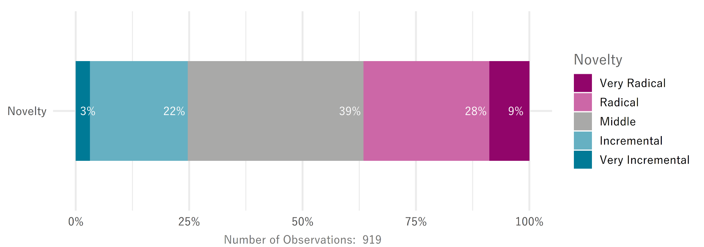
Novelty of innovations
Question: How would you rate the degree of novelty of the innovations of your company in the last two years?
Key findings:
Respondents see their innovation activities more frequently as radical than incremental
  37% of respondents indicate radical innovations; 25% indicate purely incremental innovations
Extremes are rare
  Only 9% see their innovations as very radical; only 3% see their innovations as very incremental
Mixture is most common
  About 39% of all respondents see their innovation activity as something between incremental and radical
Notes:
Incremental innovations are further developments and optimizations of what already exists.
Radical innovations or basic innovations, on the other hand, involve fundamental innovations and changes, mostly of a technological nature.
Both encompass products, services, processes, business models or the organization of the company.

Slide 30
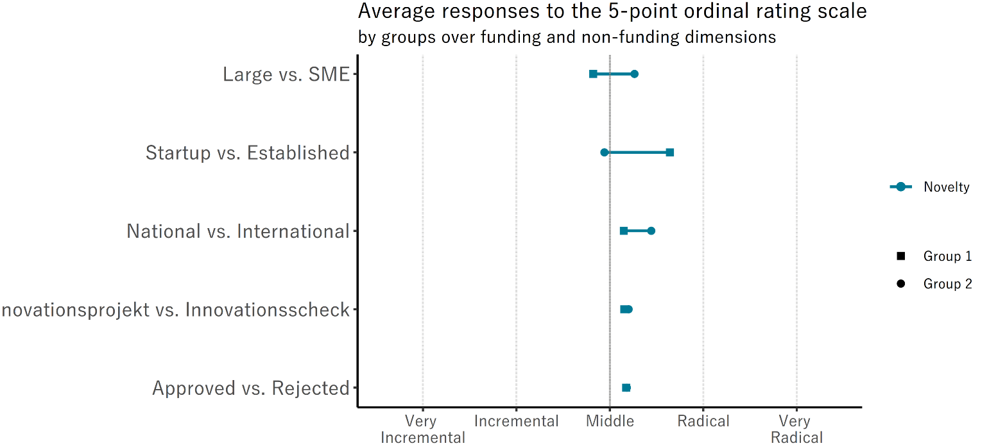

Novelty of innovations
Question: How would you rate the degree of novelty of the innovations of your company in the last two years?
Key findings:
On average, most groups see their innovations somewhere between incremental and radical
No differences in the novelty of their innovations
  Approved or rejected applicants assess the novelty of their innovations the same
  There are no differences between approved projects and cheques either
Some groups show a clear tendency towards more radical innovations
  International collaborators see their innovations as more radical than national collaborators
  SMEs and Startups with more radical innovations than large enterprises and established companies

Slide 31
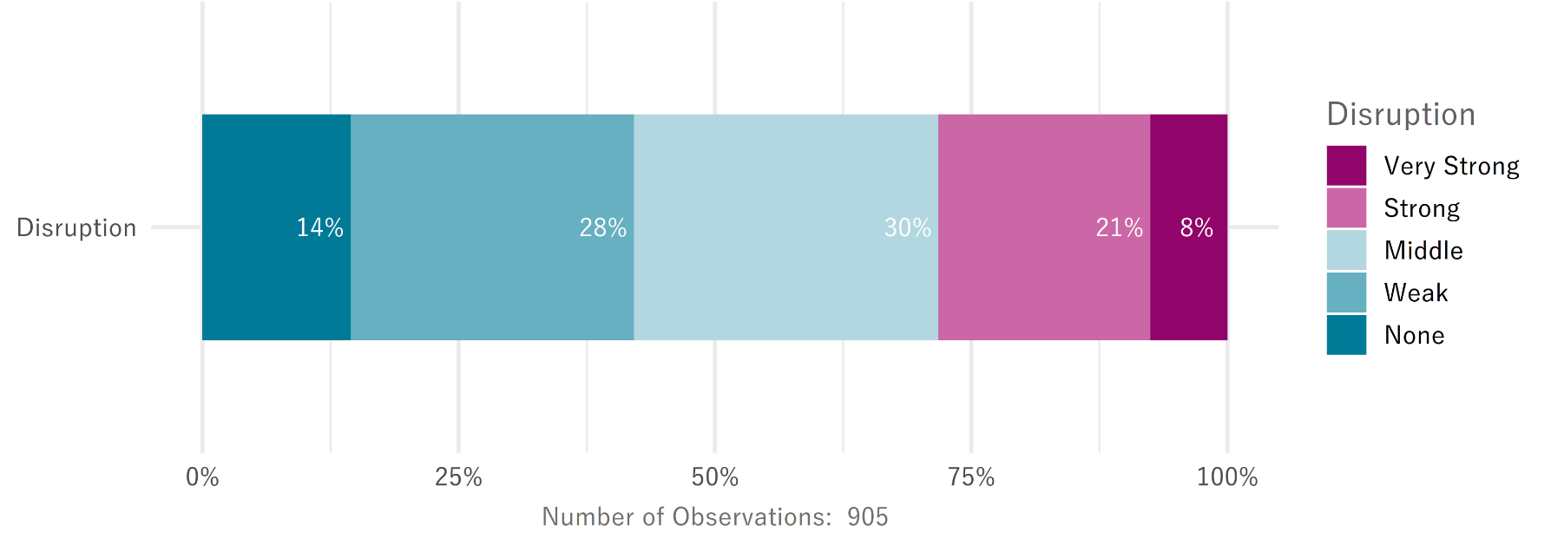
Disruption of innovations
Question: Do the product and process innovations of the last five years of your company show disruptive effects?
Key findings:
A strong disruptiveness is not uncommon
  29% of all respondents see their innovations as strongly or very strongly disruptive
Most firms see some disruption behind their innovations
  Only 14% see no disruptiveness
Most firms see a limited disruptiveness of their innovations
Notes:
Disruptive innovations create completely new markets with new rules of the game and new target groups and/or succeed in pushing previously successful companies out of the market with new technologies or business models.

Slide 32
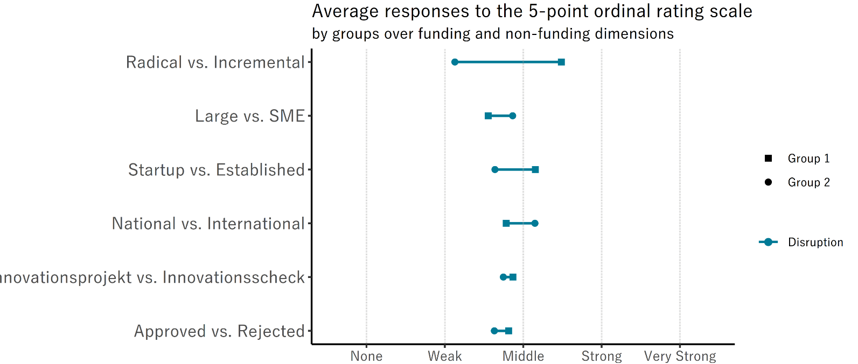

Disruption of innovations
Question: Do the product and process innovations of the last five years of your company show disruptive effects?
Key findings:
On average, most groups see their innovations somewhere between weakly and middle disruptive
  Only startups, firms that receive international funding and especially those that see their innovations as radical record an average disruption that is above middle
Three dimensions show no difference in the average disruption of their innovations
  Approved and rejected applicants
  Companies funded by projects and cheques
  SMEs and large firms
There are significant differences between …
  International collaborators and only national collaborators
  Startups compared to established companies
  Companies with radical innovations
Notes:
Beachte: Geförderte Unternehmen unterscheiden sich nicht signifikant von nicht-geförderten Projekten hinsichtlich Risiko, Neuigkeit und Disruption

Slide 33
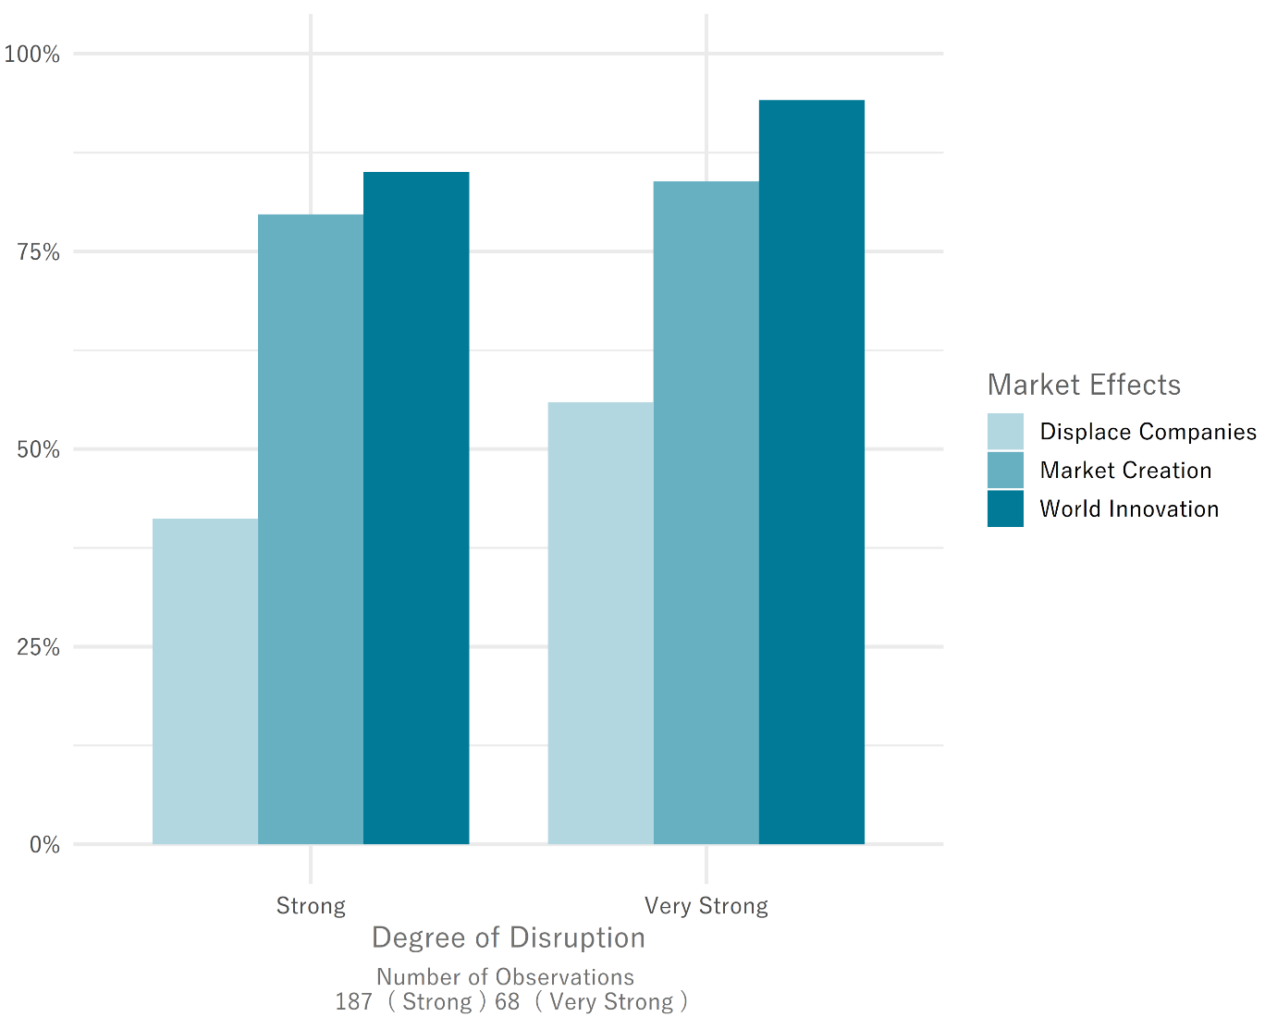
Disruption of innovations
Question: If your innovations showed disruptive effects, what are the market effects?
Key findings:
The creation of a novelty on the world market (world innovations) is the most common reason of disruption
  94% of companies that see their innovations as very strongly disruptive and 85% of those that see them as strongly disruptive say that their innovations create that market effect
The creation of completely new markets (market creation) is the second most frequent reason of disruption
  83% of those with very strongly disruptive innovations and 79% of those with strongly disruptive indicate that market effect
The displacement of companies from the market (displace companies) is the least common reason that firms attribute disruption to their innovations
The stronger the disruption, the more likely each reason becomes

Slide 34
The impact of the COVID-19 pandemic

Slide 35

The impact of the COVID-19 pandemic
Question: Does the pandemic influence the innovation processes of your company?
Key findings:
About half of all firms were not significantly impacted in their innovation endeavors by the pandemic
  17% recorded no impact at all
  32% were weakly affected
Over a quarter of all firms was substantially impacted by the pandemic
  18% were strongly impacted
  8% were very strongly impacted
The remaining quarter was significantly but not substantially impacted by the pandemic
The question is neutral! It is about the strength, not the direction of the impact

Slide 36
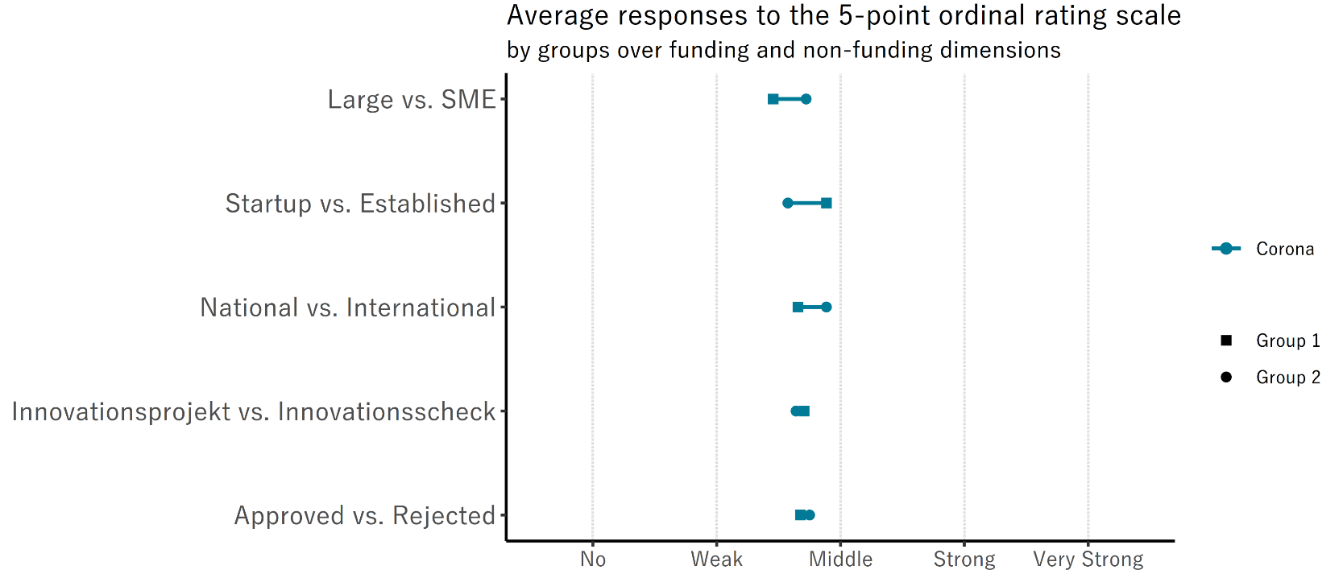
The impact of the COVID-19 pandemic
Question: Does the pandemic influence the innovation processes of your company?
Key findings:
The average impact of the pandemic is identical for
  Approved and rejected applicants
  Companies with project and cheque funding
The pandemic had a stronger average impact on
  Startups opposed to established firms
  (the difference is statistically significant at a 5% level)
  Internationally funded companies opposed to nationally funded
  (the difference is not statistically significant at a 5% level)
  SMEs opposed to large firms
  (the difference is not statistically significant at a 5% level)

Slide 37
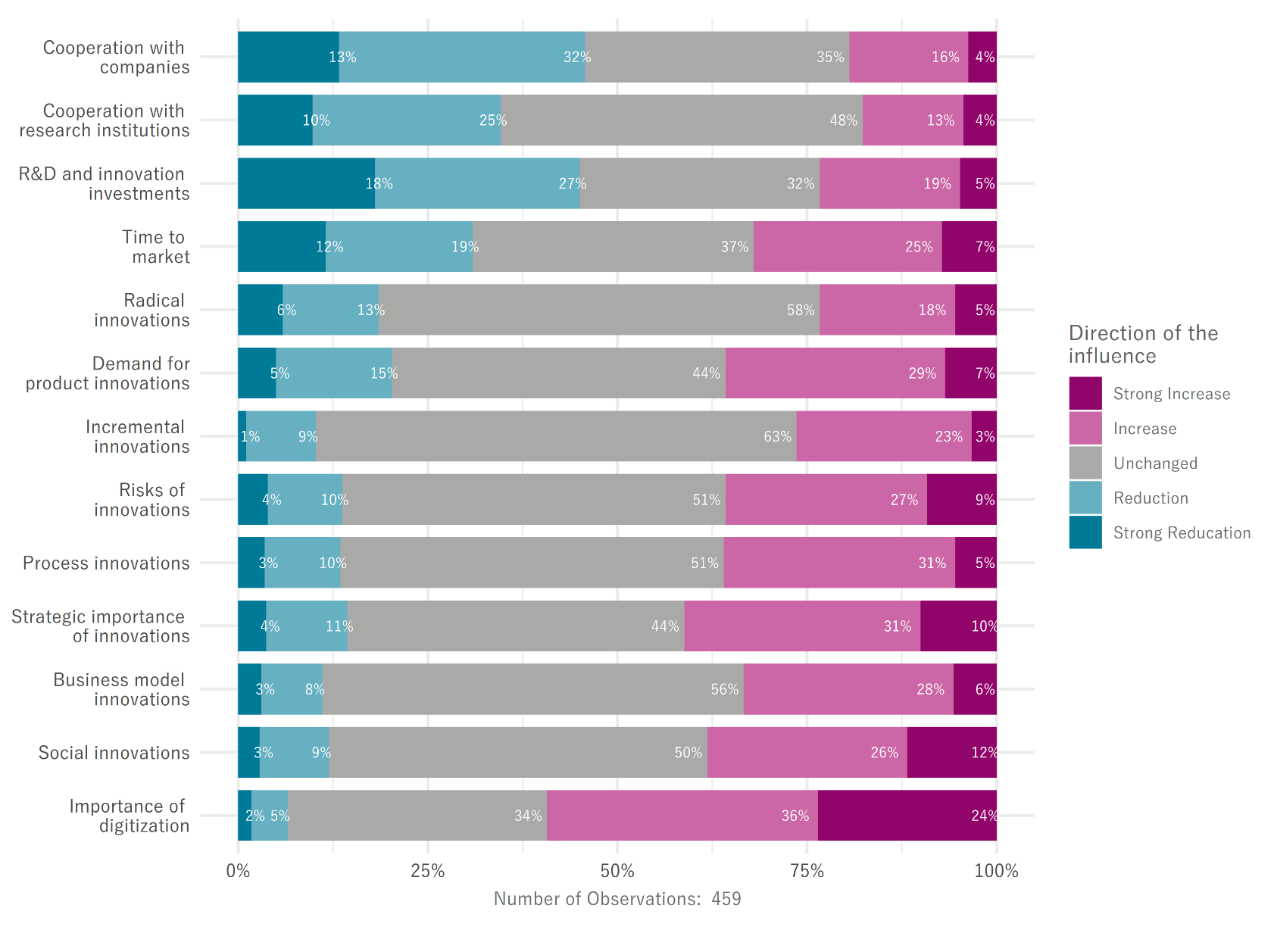
The impact of the COVID-19 pandemic
Question: If the pandemic influenced your innovation processes (middle, strong, very strong), in which areas?
Key findings:
Although half of all companies were substantially influenced by the pandemic, the direction of the impact is often positive and only few areas record predominantly negative impacts
The strategic importance of innovations increased and business models were re-invented
  41% indicate an increasing or strongly increasing strategic importance of innovations
  34% indicate an increase or strong increase in business model innovations
Digitization and social innovations became massively more important
  60% indicate an increasing or strongly increasing importance of digitization
  38% indicate an increasing or strongly increasing importance of social innovations
In some areas the pandemic had a substantial negative effect
  Slightly less than half of all companies suffered from reduced innovation cooperation
  A large share of companies had pandemic-induced reductions in their innovation investments
  Risks of innovations grew for most companies
Radical innovations are affected worse than incremental innovations
  Larger share indicates a reduced activity and smaller share indicates an increased activity
Notes:
Sometimes hard to interpret the scale: Was a strong reduction in the time to market interpreted as positive and negative?
Core issue: the scale is not normative and the normativity of the areas is item-specific (i.e. risks are negatively connotated, importance of digitization positive)

Slide 38
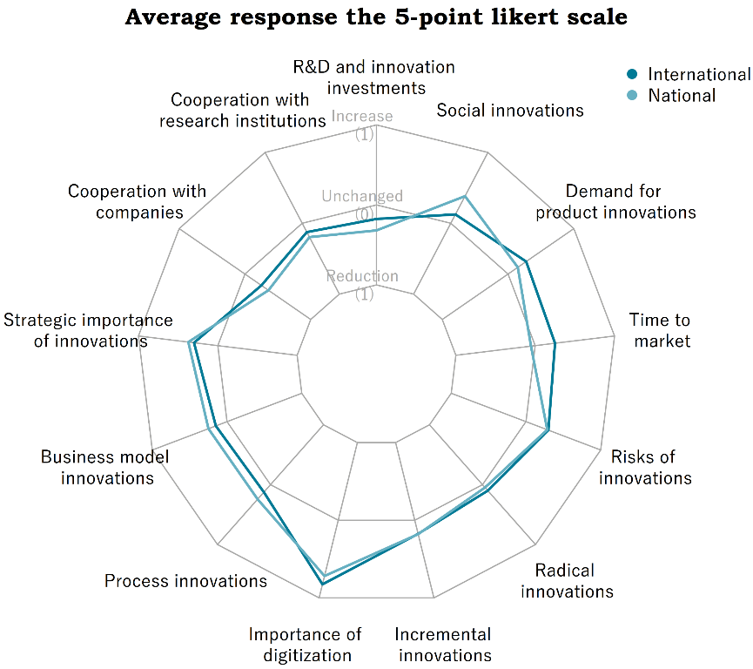
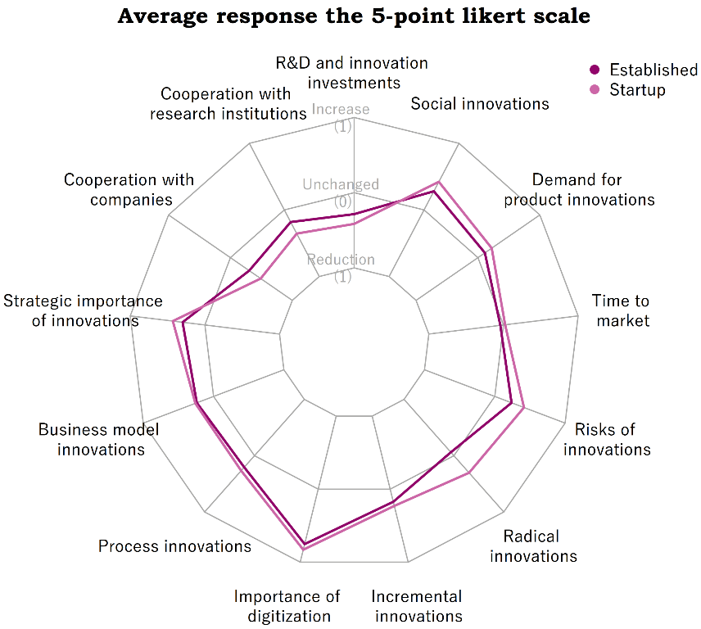
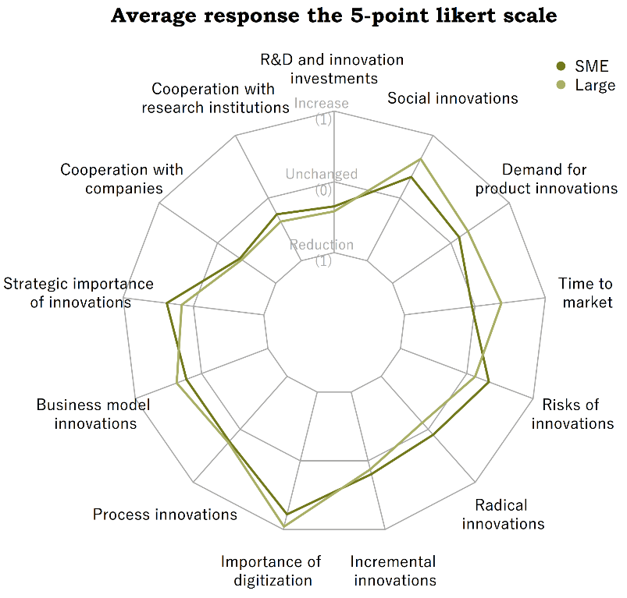
The impact of the COVID-19 pandemic
Question: If the pandemic influenced your innovation processes (middle, strong, very strong), in which areas?
Key findings:
On average, the pandemic had a similar impact on innovation activities for internationally funded a well as for nationally funded companies
  The time to market seems to increase for internationally funded while staying unchanged for nationally funded companies
  The awareness for social innovations seems to increase for nationally funded while staying unchanged for internationally funded companies
  None of the differences are statistically significant at a 5% level
The pandemic
  Reduced the cooperation with research institutions and firms, although more pronounced for startups than established firms
  Had a positive effect on radical innovations for startups while having no effect on established firms
  Increased the risks of innovations but more accentuated for startups
  Those differences are statistically significant at a 5% level while all others are not
The pandemic
  Increased the time to market for large firms while leaving SMEs unaffected
  Increased the awareness of social innovations for large firms while leaving SMEs unaffected
  However, those differences as well as all others are not statistically significant at a 5% level

Slide 39
Sustainable Development Goals

Slide 40
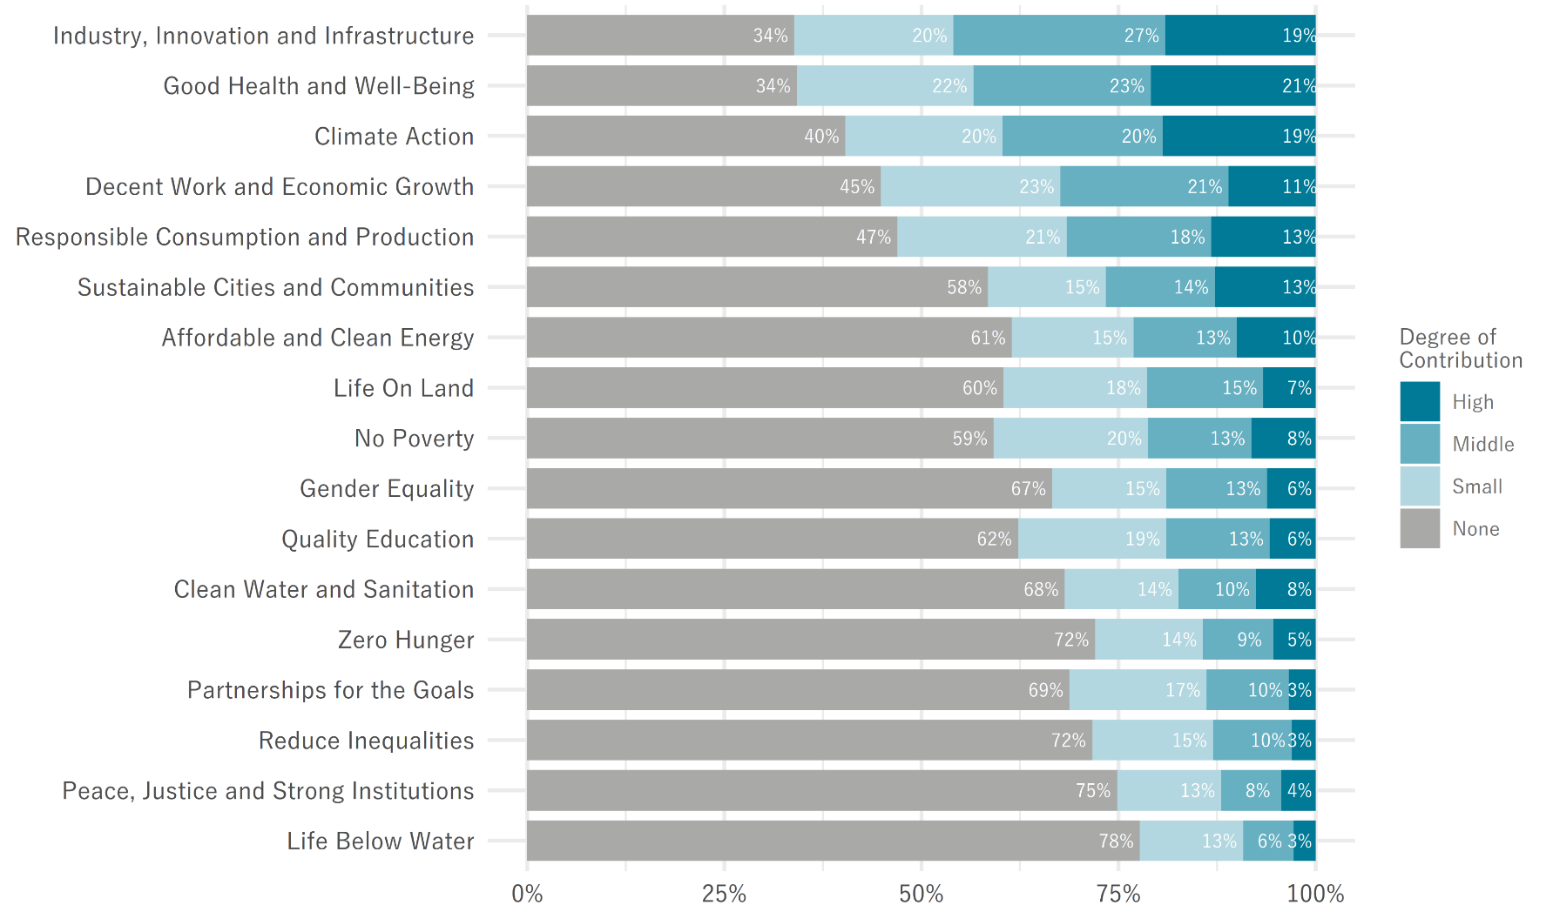
Sustainable Development Goals
Question: Do the R&D or innovation activities of your company actively contribute to the thematic areas of the United Nations' "17 Sustainable Development Goals" listed below?
The biggest contributions are in
  Industry, Innovation and Infrastructure
    46% indicate middle or high contributions.
  Good Health and Well-Being
    44% indicate middle or high contributions
  Climate Action
    39% indicate middle or high contributions
More than a quarter of all firms also contribute to
  Decent Work and Economic Growth,
  Responsible Consumption and Production
  and Sustainable Cities and Communities
Less than 15% contribute significantly to
  Life below Water,
  Peace, Justice and Strong Institutions,
  Reduced Inequalities,
  Partnerships for the Goals,
  and Zero Hunger
The SDGs in these slides are named after the UN terminology. You can find a more detailed description with the exact wording of the UN in the appendix
Notes:
Key findings:
The graph shows the share of companies by their highest contribution to a specific SDG irrespective of whether it occurred in developed or developing countries
The graph dissecting the information by developed and developing countries is in the appendix
The biggest contributions are in
Industry, Innovation and Infrastructure
46% indicate middle or high contributions to Industry, Innovation and Infrastructure, either in developed or developing countries
Good Health and Well-Being
44% indicate middle or high contributions to Good Health and Well-Being, either in developed or developing countries
and Climate Action
39% indicate middle or high contributions to Climate Action Growth, either in developed or developing countries
More than a quarter of all firms also contribute to
Decent Work and Economic Growth,
Responsible Consumption and Production
and Sustainable Cities and Communities
Less than 15% contribute significantly to
Life below Water,
Peace, Justice and Strong Institutions,
Reduced Inequalities,
Partnerships for the Goals,
and Zero Hunger

Slide 41
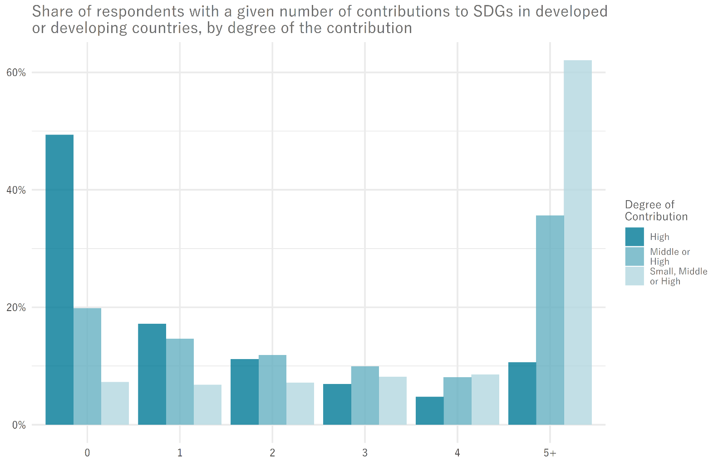
Sustainable Development Goals
Question: Do the R&D or innovation activities of your company actively contribute to the thematic areas of the United Nations' "17 Sustainable Development Goals" listed below?
Innosuisse applicants: a significant contribution to at least one SDG is quite frequent
  51% of all respondents have at least one high contribution
  29% of all respondents have at least one middle contribution but no high
  13% of all respondents have at least one small contribution but no middle or high
  7% of all respondents have no contribution
Contributions to multiple SDGs (5+) is frequent
  62% considering some contribution (small, middle or high)
  36% considering significant contributions (middle or high)
  11% considering high contributions
The SDG contributions occur more frequently and to a higher degree in developed countries
Note:
The first category of bars is the most informative one. It shows the share of respondents that do not contribute to any SDG by at least a certain degree. The minimal degree of the contribution is indicated by the coloring (high, middle small).
As such, the first bar says that 49% do not have a high contribution to any SDG. The second bar says that 20% do neither have high nor middle contributions to any SDG.
This can be inverted to state that 80% have a middle or high contribution to at least one SDG and 51% have a high contribution to at least one SDG.
The difference between those bars also has a meaning namely that 29% of respondents have no high contribution (and thus either middle, small or no contributions) but at least 1 middle contribution (since otherwise they would belong to the 20% that have no high or middle contributions). The same logic applies for the last bar concerning at least small contributions.

Slide 42
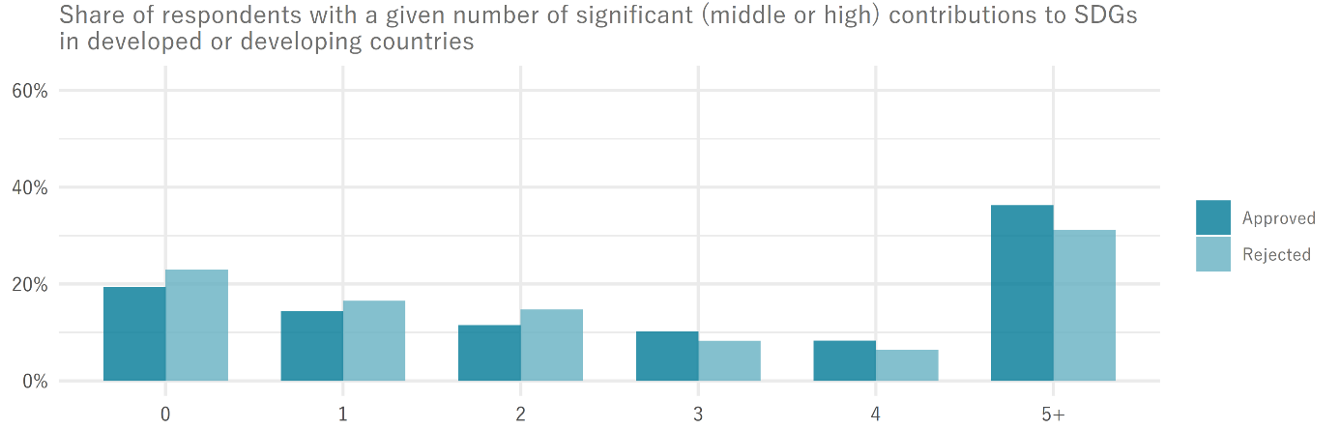
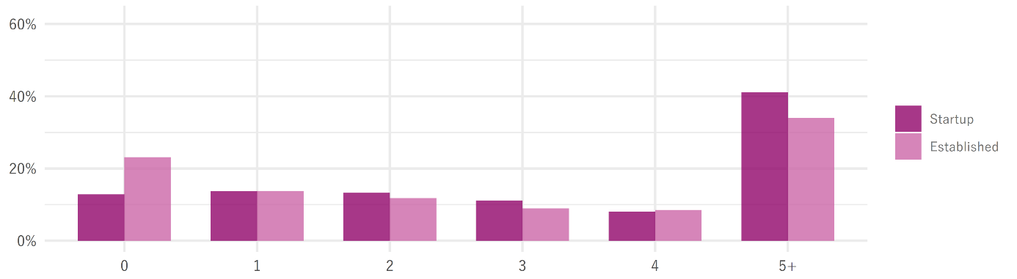
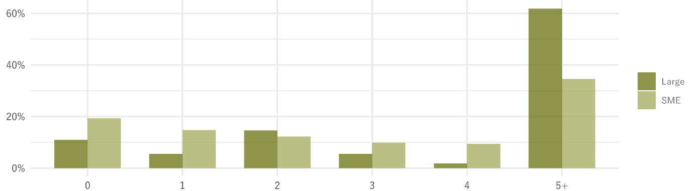
Sustainable Development Goals
Question: Do the R&D or innovation activities of your company actively contribute to the thematic areas of the United Nations' "17 Sustainable Development Goals" listed below?
Approved applicants contribute to more SDGs than rejected ones
  55% of approved applicants have a middle or high contribution to 3 or more SDGs while the share for rejected applicants is 46%
  This is no proof that the contribution to SDGs is a selection criteria for innovation funding
Startups have more contributions than established firms
  41% of startups have middle or high contributions to 5+ SDGs while only 34% of established firms do so
  23% of established firms have no middle or high contributions to any SDGs while only 13% of startups
Large firms have substantially more contributions than SMEs
  62% of large firms have middle or high contributions to 5+ SDGs while only 35% of SMEs
  Firm size (and likely financial capacity) is an indicator for firms contribute to more SDGs
Notes:
We cannot say that the contributions to SDGs are a selection criteria (approve or reject the application for funding) because we
don’t know when these contribution were made
have no possibility to verify the plausibility of the responses
cannot account for response bias
have no means to assess the causality of the relationship (were SDG contributions truly a cause for funding or was it vice versa or do third factors like financial capacity yield or impede this correlation)

Slide 43
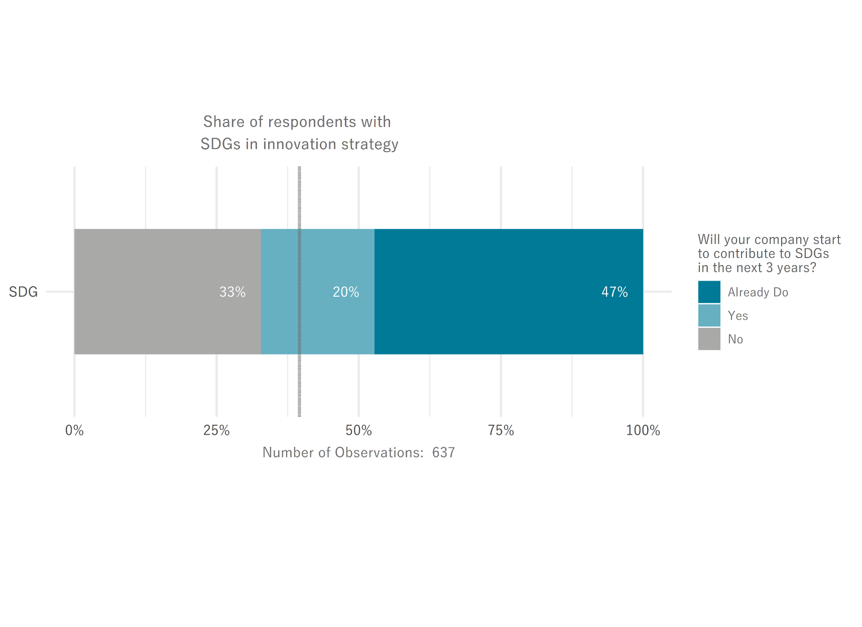
Sustainable Development Goals
Question: Will your company contribute to the one of the 17 Sustainable Development Goals in the next three years?
Answers: Won’t contribute, will start to contribute, are part of the documented innovation strategy, already are contributing
Almost half of all respondents are already contributing to the SDGs
38% of non-contributors start to contribute within the next three years
1/3 of respondents will not contribute to SDGs in the next three years and 2/3 will contribute
  Compared to the 80/20 ratio of companies that indicate that they made some significant (middle or high) contribution to any SDG in the past, the contributions in the next three years will be slightly lower
  This might be a result of a smaller time span (only 3 years opposed to open ended)
  SMEs and established companies are more likely to have no contributions in the next three years
About 40% of all respondents anchored the SDGs in their innovation strategy
40%
Notes:
This question underwent some heavy cleaning. The idea behind this question is interpreted as follows:
Three of the answer items are mutually exclusive and jointly exhaustive meaning each company must answer one and only one of the following:
- Our company will not make any contributions to SDGs in the next three years
- Our company will start to make contributions to SDGs in the next three years
- Our company is already contributing to SDGs [and will continue to do so in the next three years]
To get mutually exclusive and jointly exhaustive data I applied the following cleaning:
- If all three are 1 or 0 the answer is invalid and dropped
- If one is missing and at least one of the others is 1, it is set to 0 [mutually exclusive]
- If multiple 1s exist precedence is given to seniority (already are > yes > no)
- If one is missing and the others are 0, it is set to 1 [jointly exhaustive]
Seperated from that, another answer is if the SDGs are part of the documented innovation strategy. This seems to be independent of the contribution decision and hence was not cleaned at all.

Slide 44
Turnover shares of firm and market novelties

Slide 45
Turnover shares from innovations
Technical notes
Innosuisse clientele comprises firms that applied for funding from Innosuisse since 2016
Approved applicants comprise approved innovation cheques or innovation projects
Control group comprises firms that never applied for funding from Innosuisse since 2016, but are R&D active
The reported percentages are the average shares of turnovers from innovations per group in the year 2020 of firms that have product innovations
  Product innovations comprise new (a1) and improved (a2) products
  And can also be divided into those that are only new to the firm (b1) or new to the market (b2)
  Both divisions add up to the total product innovations (a1 + a2 = b1 + b2)
Average share of turn- over in 2020 from (in %) | Innosuisse applicants (N = 311) | Approved applicants (N = 283) | Approved projects (N = 175) | Control group (N = 275)
Product innovations | 55.0 | 54.4 | 51.7 | 30.4
… new to the firm | 31.0 | 30.6 | 29.9 | 24.7
… new to the market | 24.0 | 23.7 | 21.8 | 5.7
Opposed to R&D active firms that never applied for Innosuisse funding (control group),
  Innosuisse applicants, approved applicants (cheques and projects) and approved project applicants have substantially higher turnover shares from product innovations, especially from market novelties
  Approved and rejected applications have comparable turnover shares from innovations while approved project applicants have slightly lower turnover shares, especially from market novelties
  The distribution of turnover shares is comparable across all groups with one exception: Innosuisse firms (all except control group) report substantially more often that 100% of their turnover stems from innovative products.
Those differences do not allow any causal statements
  We cannot say if the Innosuisse is responsible for a higher share of market novelties
  We also cannot say if firms with more radical or disruptive innovations apply more frequently for Innosuisse funding since the shares are measured at the end of the survey period, i.e. in 2020
Notes:
This calculation deviates from the approach used by EUROSTAT: they use the cumulative turnover of product innovators from product innovations, that, divided by the cumulative turnovers of those product innovators, yields the weighted average turnover shares of product innovators with weights equal to each product innovators share in total turnovers from all product innovators. This makes the weighted average more reliant on product innovators with big turnover shares, opposed to our measure that simply uses the equally weighted average such that each firm receives the same weight.

Slide 46
Continuation of monitoring

Slide 47
Benefits of continued monitoring
Monitoring allows measurement of the evolution of the Innosuisse Clientele
  Important basis for evaluation studies, e.g., short and long-term performance effects of the Innosuisse funding
  Basis for measuring the impact of funding measures
  Important basis to identify temporal trends - requires information from the same companies (panel) from at least 3 points in time
  Monitoring allows comparisons over time and between innovative companies
  Comparisons between Innosuisse clientele and other innovative companies
  Creates basis for in-depth control group analyses between supported and non-supported companies
Empirical basis for new "policy designs“
  Recognizing longer-term trends is important for better policy measures
  Anecdotal evidence is often insufficient for design changes and makes it difficult to take sensible or discontinue ineffective measures

Slide 48
Benefits of continued monitoring
Platform for contemporary problems
  Repeated panel maintenance allows adaptation of surveys to current issues
  e.g., COVID-19, SDGs, Digital Transformation
Data availability in the KOF Microdata Centre - access for all researchers
  Information sharing benefits research and scientific advancement
  Benefits for applied research and evaluations of real-world issues
Reliable empirical basis for political inquiries, reports, presentations, or statements
  Statistical material can be processed for different formats and provides broadly supported facts on various topics relevant for Innosuisse

Slide 49
Appendix
The appendix contains all the auxiliary information created during the evaluation including graphs and tables used in earlier presentations

Slide 50
Sample and Response

Slide 51
Sample composition and response rates
Non-responder
2539 (70.6%)
# of firms in NINT that respond to ISU
# of firms in INT that respond to both ISU and PAN
There is a total of 3595 applicants
  2106 observations have an application after the ISU 2019
  1489 observations only have applications prior to the ISU 2019
535 applicants are also part of the KOF Enterprise Panel and by default part of the KOF Innovation Survey PAN (INT i.e. intersection)
3060 have no obligation to fill out the KOF Innovaiton Survey (NINT i.e. non-intersection)
Both set of firms can respond to either survey encouraged by the merger of the Innosuisse Survey [ISU] and the KOF Innovaton Survey [PAN]
Response rates are substantially higher than in pilot project
  29.4% (vs. 23.4% in 2019) answer ISU
  19.0% (vs 11.4% in 2019) answer both ISU and PAN
Everyone that answered the PAN also answered the ISU
  no cases left that only answer the PAN
  explained by the merger of the surveys and precedence of ISU
Responsiveness is higher for INT (40.0%) opposed to NINT (27.5%)
  May be due to smaller sample size or due to the fact that they are more accustomed to fill out KOF surveys
INT
535
321
2218
214
842
143
539
ISU responder
1056 (29.4%)
PAN responder
682 (19.0%)
NINT
3060
sample size of NINT (including respondents and non-respondents
# of cases
response rate (of INT + NINT)
Notes:
The 2106 new funding applicants are those that can be linked to newer funding applications (newest file sent of which 169 cannot be linked to the sample)
The 1489 old funding applicants are those that can be linked to older funding applications (older file sent of which 223 cannot be linked to the sample), if they cannot be linked to newer funding application (which are therefore assumed as not having a newer application)

Slide 52
Response rates
by subcategory, in % points
The response rate is balanced between firms that applied for projects or cheques
Firms that received the funding are far more responsive than firms that did not receive funding
  This lack of response from rejected applicants might introduce response bias, but we cannot assess the size of the bias due to a lack of non-response analysis
A breakdown for different firm sizes, ages and industry affiliations is not possible since the former two rely on firm’s reported values in the surveys (which are trivially not available for non-participants) while information on the latter was not provided by Innosuisse.
 | 2019 | 2021 | Overall
Applied for
Innovation project | 23.9 | 30.0 | 27.5
Innovation cheque | 22.5 | 28.6 | 26.5
Application received
Approval | 25.5 | 34.4 | 31.0
Rejection | 18.0 | 15.6 | 16.5
Overall | 23.4 | 29.4 | 27.1
Notes:
The numbers refer to the share of firms that responded to the Innosuisse survey (ISU) or both the Innosuisse and the Innovation survey (ISU + PAN)
No decomposition possible for firm size, age and industry affiliation as those are based on answers the firms provide in the Innovation survey. If firms don’t participate, they don’t record any values which makes it impossible to categorize non-responders into size, age and industry clusters. This again makes the calculation of response rates per cluster impossible.

Slide 53
Development of innovation activities

Slide 54
Development of innovation activities
Questions: How did the innovation activities in your company develop in the last 3 years?
How will the innovation activities in your company develop in the next 3 years?
 |  | Past 3 years |  | Next 3 years
 |  | 2019 | 2021 | 2019 | 2021
How did the innovation activities in your company develop? (in %) | Strong Reduction | 0.8 | 1.4 | 1.6 | 2.1
 | Reduction | 4.7 | 6.4 | 6.0 | 6.5
 | Unchanged | 31.6 | 36.8 | 23.3 | 30.7
 | Increase | 43.4 | 43.0 | 42.3 | 41.6
 | Strong Increase | 19.5 | 12.5 | 26.8 | 19.1

Slide 55
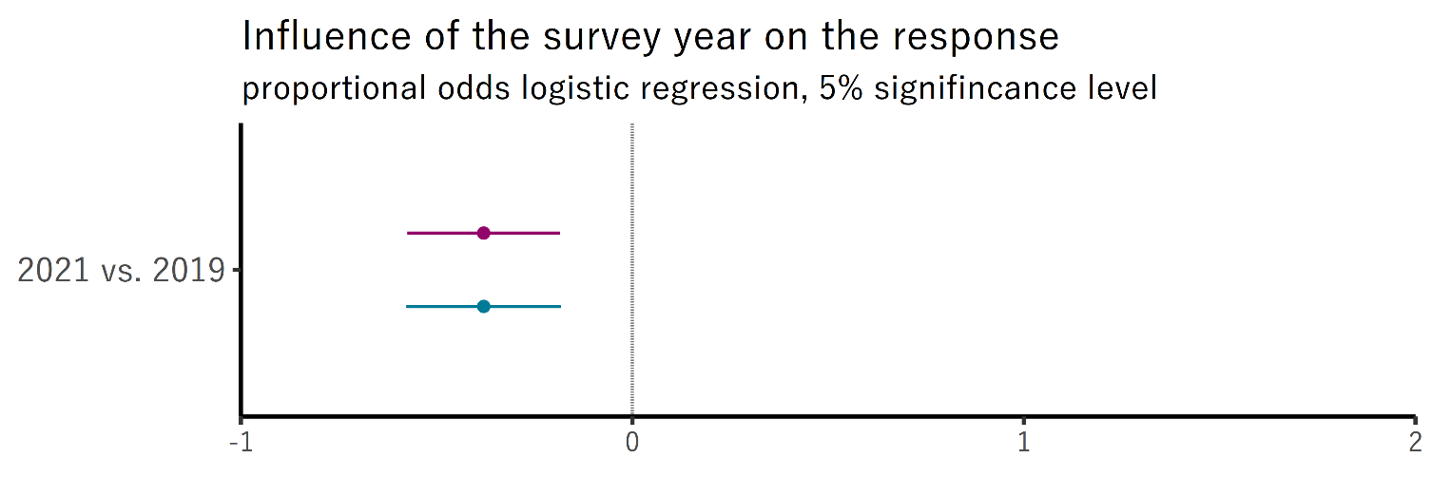
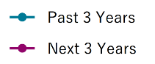
Development of innovation activities
Questions: How did the innovation activities in your company develop in the last 3 years?
How will the innovation activities in your company develop in the next 3 years?
This graph shows the sign and statistical significance of the difference between the replies to the two above questions between 2021 and 2019.
Since these replies are measured on an ordinal scale, it is best to apply an ordinal regression model, in our case a proportional odds logistic regression
The validity of the proportionality assumption is checked for each regression
The graph indicates if the two groups differ in their response to every category of the ordinal variable (here every level between strong reduction and strong increase) and if these differences are statistically significant
In this case, we see that the responses to the past and expected future development of a firm’s innovation activities were slightly lower in 2021 and that these results are statistically significant on a 5% level.
Notes:
Average developments

Slide 56
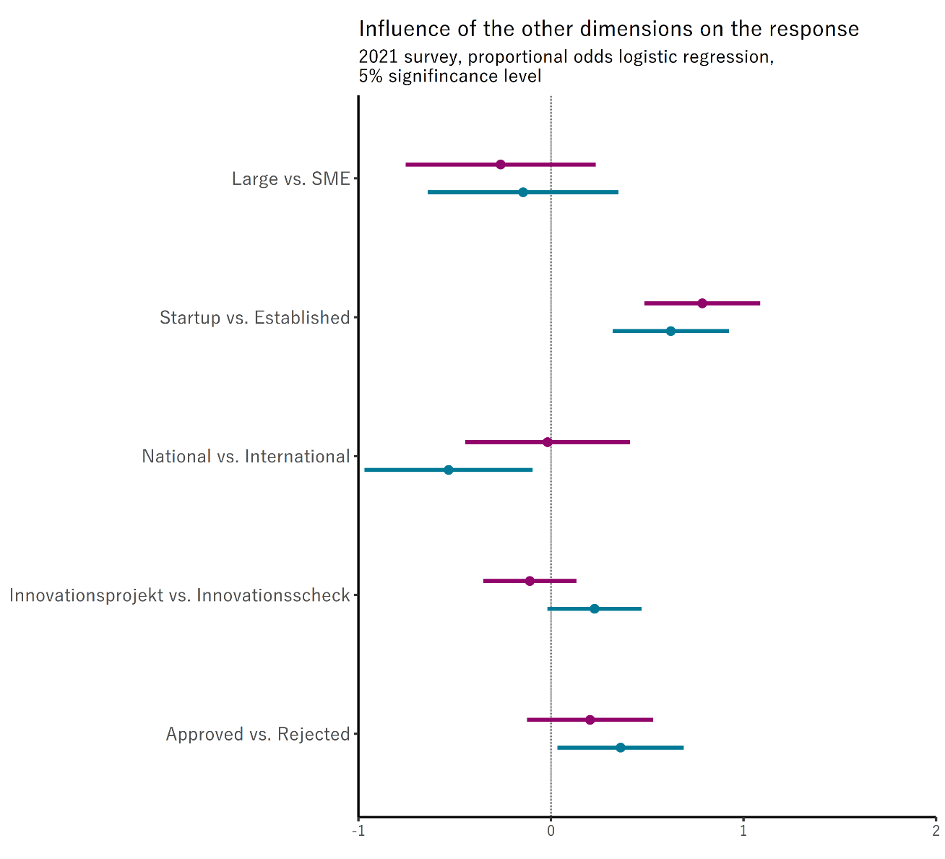
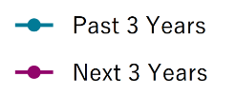
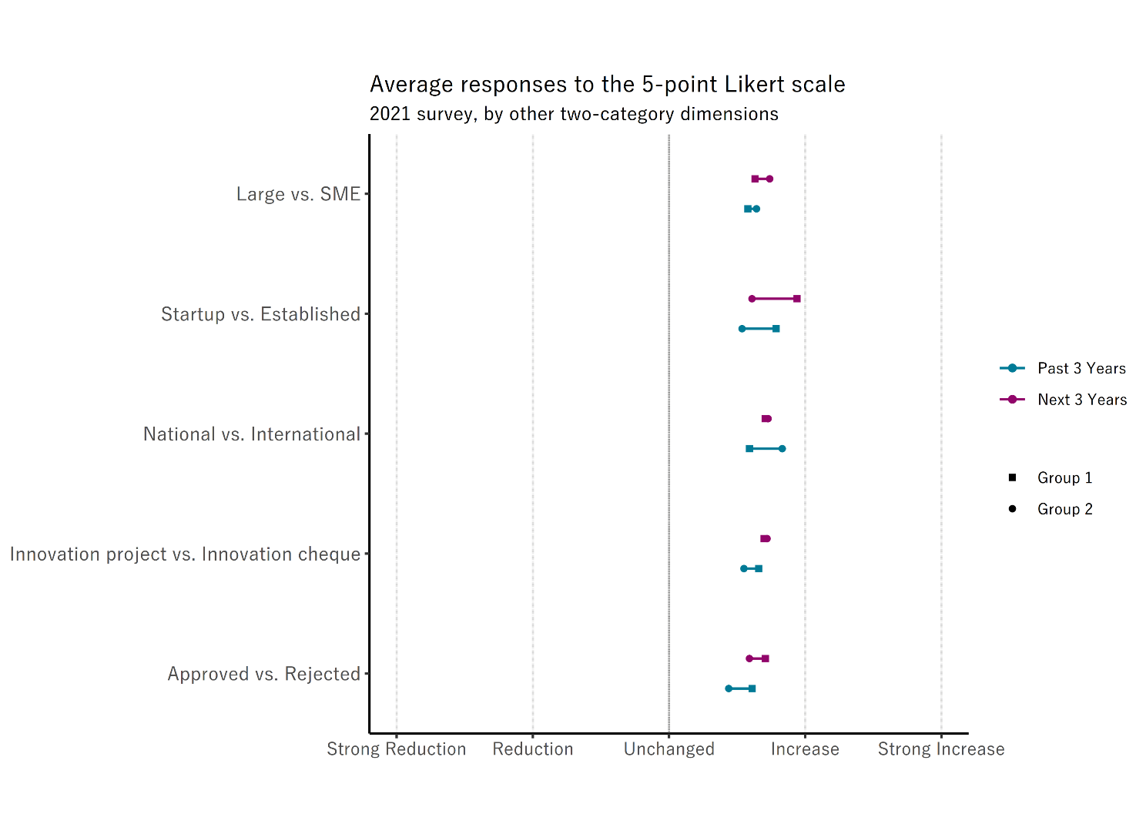
Development of innovation activities
Questions: How did the innovation activities in your company develop in the last 3 years?
How will the innovation activities in your company develop in the next 3 years?
Key findings:
The only differences between the responses of groups to their realized past and expected future development of innovation activities that are statistically significant at a 5% level are:
  Approved funding proposals have better past developments
  Internationally funded have better past developments
  Startups have better past and expected future developments
  All of these are highlighted in the main slides
Once again,
  these differences only stem from 2021 survey data
  The dots and lines correspond to the point estimate and confidence intervals from a proportional odds logistic regression where the validity of the proportionality assumption was checked
Notes:
Refer to the survey in 2021

Slide 57
Risk of innovation activities

Slide 58
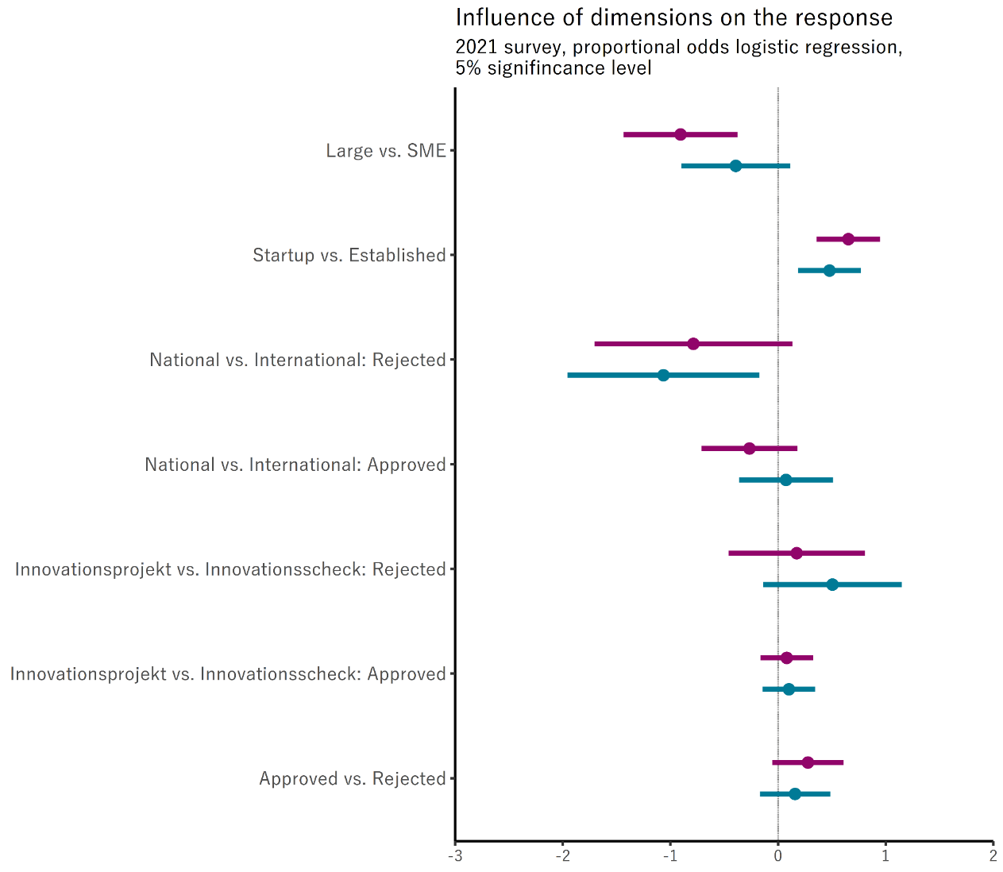
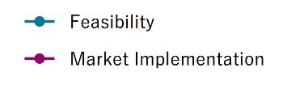
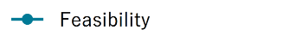

Risk of innovation activities
Questions: How high are the R&D and innovation risks of your company related to feasibility?
How high are the R&D and innovation risks of your company related to market implementation?
Key findings:
The only statistically significant differences at a 5% level concerning innovation risks are
  Companies that apply for international funding but get rejected have higher feasibility risks than companies that apply for national funding and get rejected
  Startups have higher feasibility and market implementation risks than established companies
  SMEs have higher market implementation risks than large companies
Once again,
  these differences only stem from 2021 survey data
  The dots and lines correspond to the point estimate and confidence intervals from a proportional odds logistic regression where the validity of the proportionality assumption was checked

Slide 59
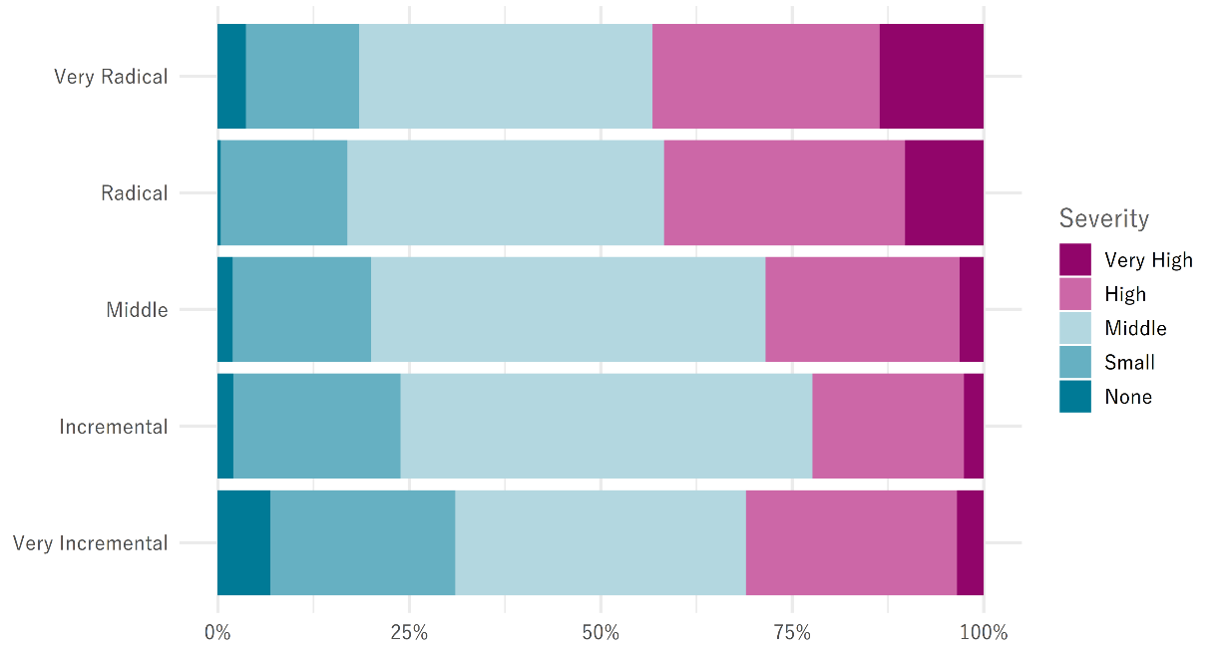
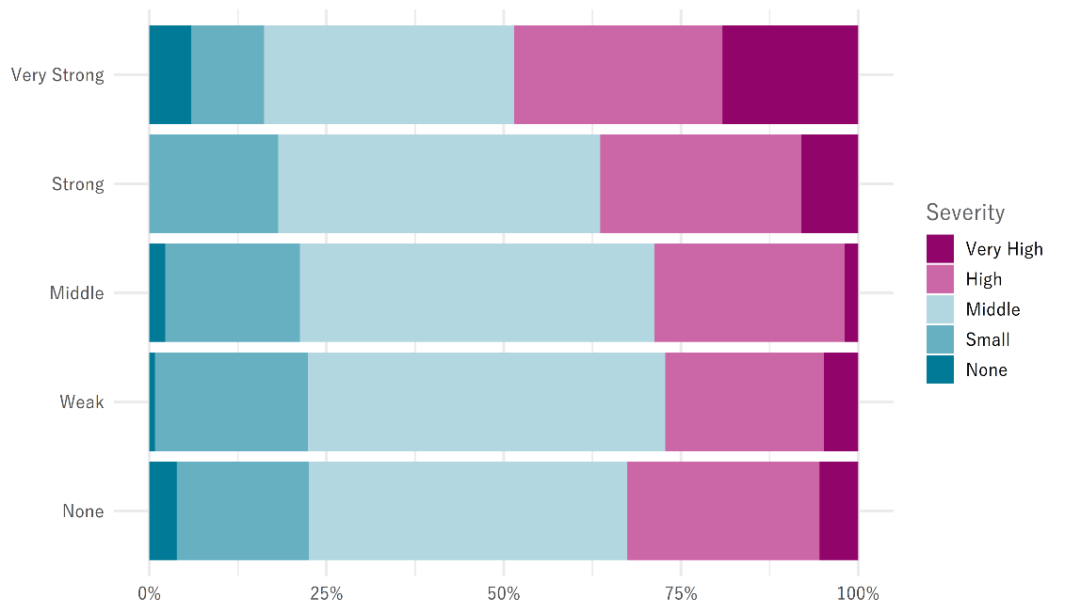
Risk of innovation activities
Questions: How high are the R&D and innovation risks of your company related to feasibility?
Novelty of innovation
Disruptiveness of innovation
High and very high feasibility risks are more common among firms with radical and disruptive innovations

Slide 60
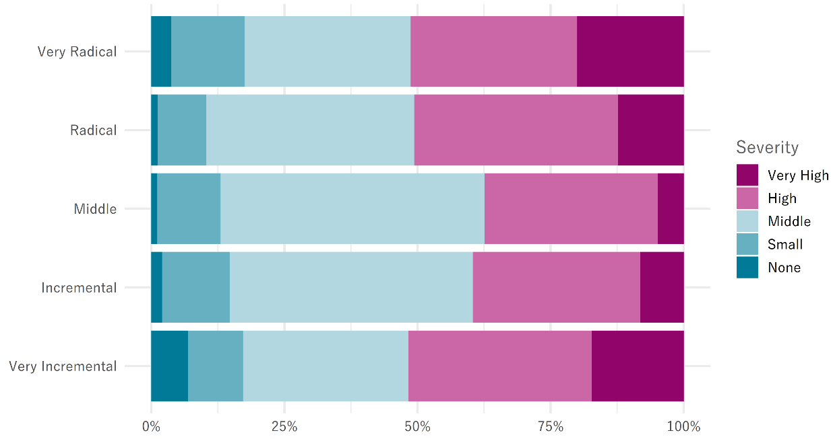
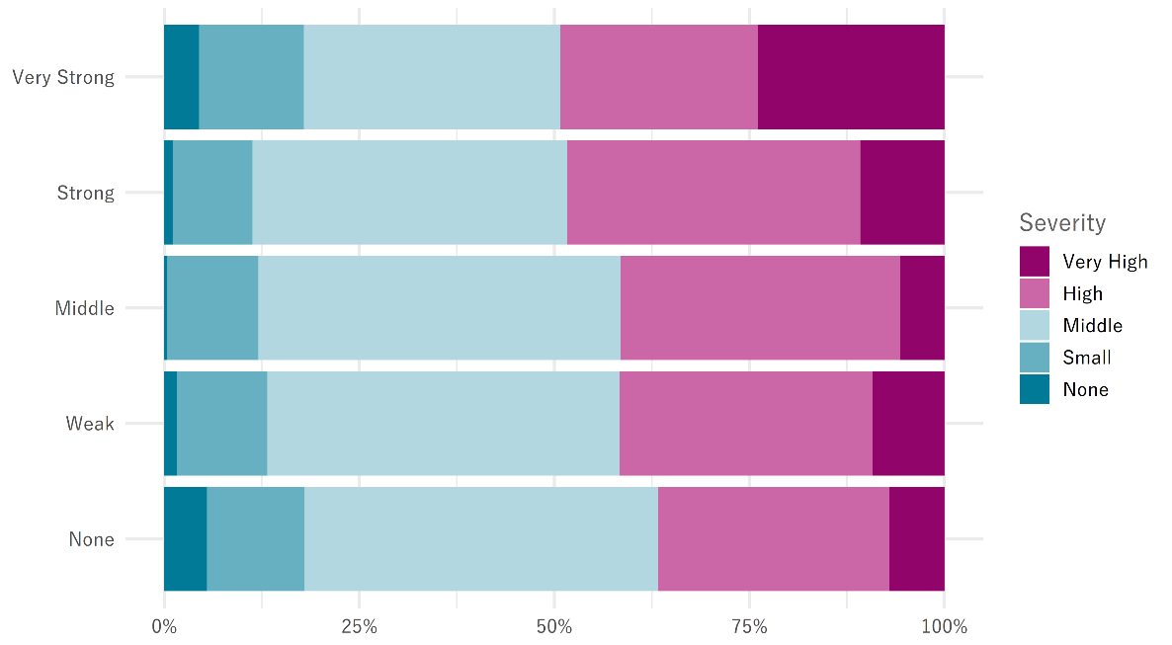
Risk of innovation activities
Questions: How high are the R&D and innovation risks of your company related to market implementation?
Novelty of innovation
Disruptiveness of innovation
Market implementation is the far bigger risk and equally pronounced among firms irrespective of the novelty of their innovations
Very high market implementation risks are more pronounced among firms with higher disruptiveness of their innovations

Slide 61
Utility of innovation support

Slide 62
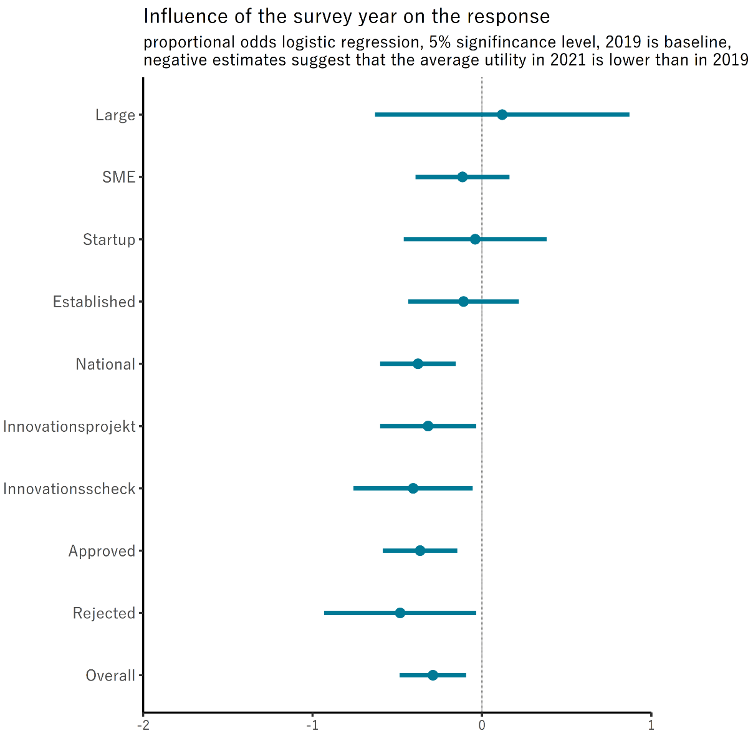

Utility of innovation support
Question: How would you rate the overall utility of Innosuisse's innovation funding?
Key findings:
The statistically significant reductions in the average utility assigned to the Innosuisse’s innovation support between 2019 and 2021 at a 5% level occur only for the following funding dimensions
  Rejected applications
  Accepted applications
    Cheques as well as Projects
    Nationally funded companies (international is not assessable)
Once again,
  these differences only stem from 2021 survey data
  The dots and lines correspond to the point estimate and confidence intervals from a proportional odds logistic regression where the validity of the proportionality assumption was checked
Notes:
Project vs Cheque / International vs National again only apply to approved applications

Slide 63
Innovation Promotion Instruments

Slide 64
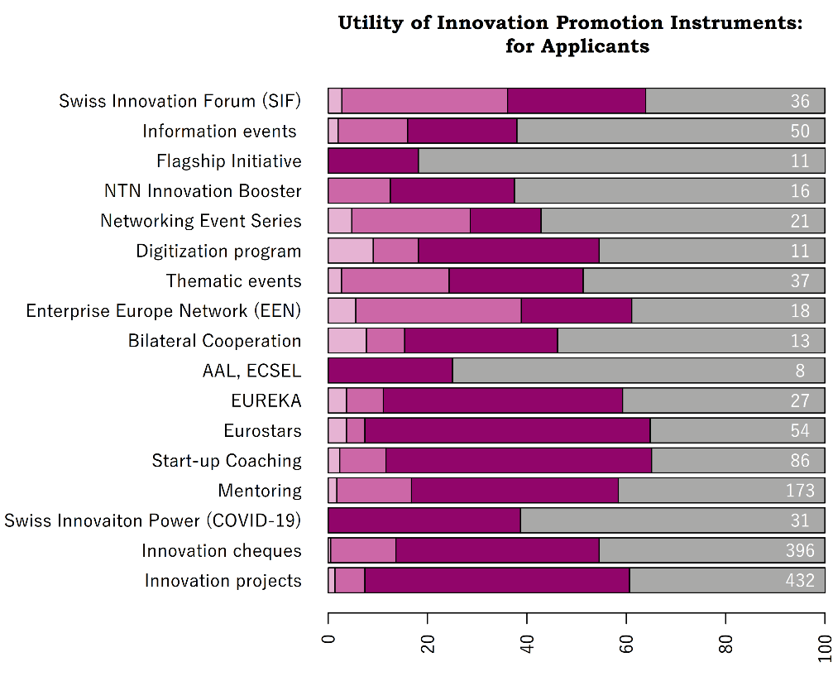
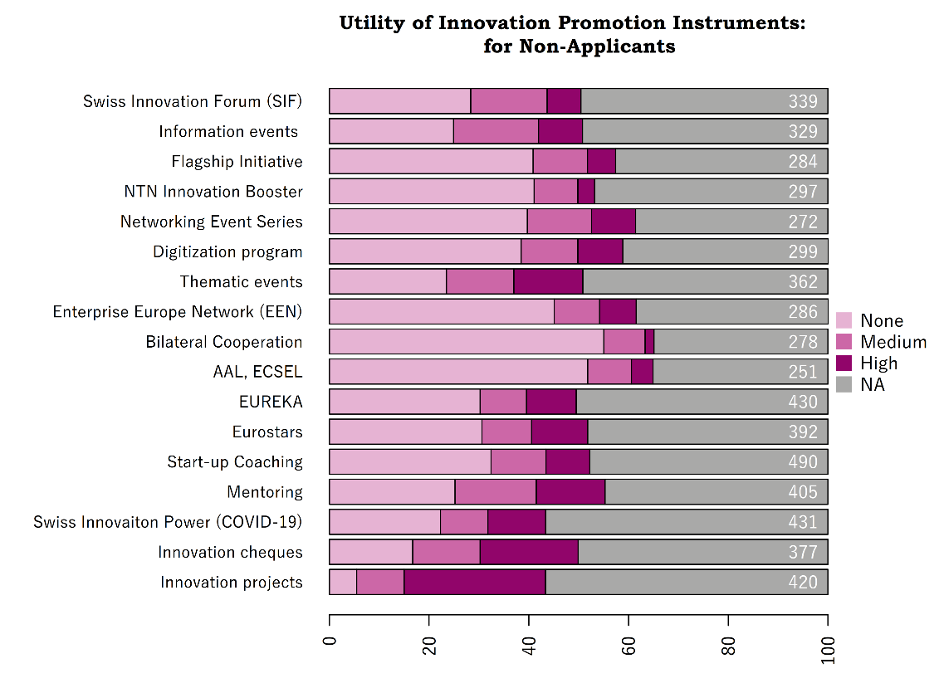
Innovation Promotion Instruments
Question: How do you assess the utility of these instruments for your company?
Key findings:
Applicants assign a high utility to the respective innovation promotion instrument
  There are almost no firms that applied to a promotion instrument but see no utility in the instrument
  For most instruments, applicants assign a high utility (except for EEN, Nationale Netzwerke, and SIF where a medium utility dominates)
Non-applicants often see no utility in the instruments
  Except for Innovation projects and Innovation cheques, where even non-applicants see a high (or medium) utility more often (is probably driven by the fact that they applied for at least one of the two, otherwise they would not be in the sample)
These results carry a lot of uncertainty and should not be regarded as representative of the true satisfaction with the instruments
  Applicants and non-applicants most often fail to indicate if they derive any utility of the instruments (NAs), and we cannot say where those NAs would go (none, medium or high utility)
  For many instruments, the number of applicants is low aggravating the uncertainty towards the true utility even further
Notes:
Applicants are those that answered that they know an instrument (question B.A) and that they applied for it in the past (question B.B)
Non-Applicants are those that answered that they know an instrument (question B.A) and that they have not applied for it in the past (question B.B)
The NAs result from firms that indicated that they know of the instrument (question B.A) but failed to report the utility of the instrument (neither high, medium nor none). These utility levels are mutually exclusive and jointly exhaustive such that exactly one must be answered, especially for applicants)

Slide 65
International innovation collaboration

Slide 66
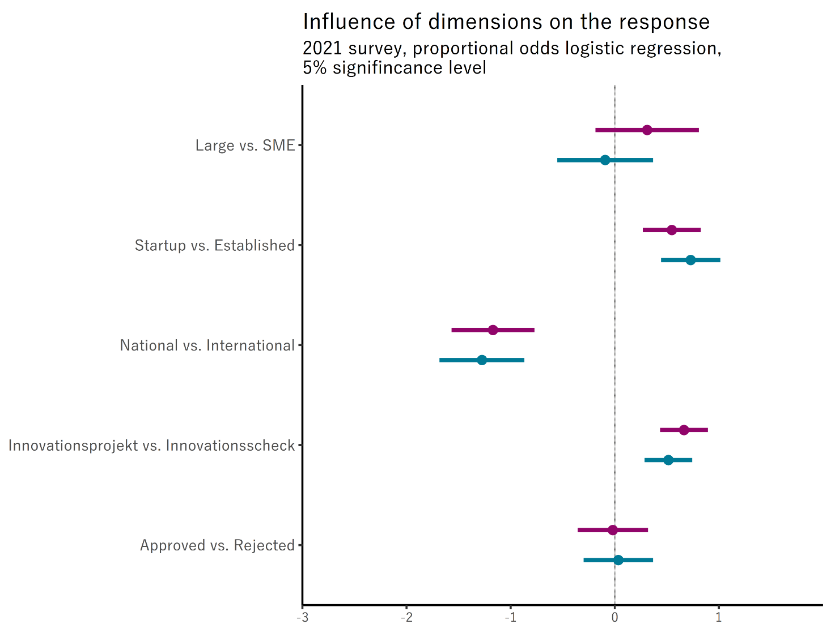

International innovation collaboration
Questions: How relevant is innovation collaboration with foreign companies for your company?
How relevant is innovation collaboration with foreign research organizations for your company?
Key findings:
The statistically significant differences in the relevance of international collaborations at a 5% level occur for the following dimensions
  more relevant for applicants to “Innovation projects” than “Innovation cheques”
  more relevant for applicants to “International” than “National” innovation funding (truism)
  more important for “Startups” than “Established”
Once again,
  these differences only stem from 2021 survey data
  the dots and lines correspond to the point estimate and confidence intervals from a proportional odds logistic regression where the validity of the proportionality assumption was checked
Notes:
Here, «International vs National» and «Innovation project vs Innovation cheque» again comprise all companies that applied for such a funding not just those that were funded by on of those means

Slide 67
Novelty and disruption of innovations

Slide 68



Novelty of innovations
Question: How would you rate the degree of novelty of the innovations of your company in the last two years?
Key findings:
The statistically significant differences in the degree of novelty of innovations at a 5% level occur for the following dimensions
  International indicate more radical innovations than National
  Startups indicate more radical innovations than Established
  SMEs indicate more radical innovations than Large
Once again,
  these differences only stem from 2021 survey data
  the dots and lines correspond to the point estimate and confidence intervals from a proportional odds logistic regression where the validity of the proportionality assumption was checked

Slide 69




Disruption of innovations
Question: Do the product and process innovations of the last five years of your company show disruptive effects?
Key findings:
The statistically significant differences in the disruptiveness of innovations at a 5% level occur for the following dimensions
  International indicate more radical innovations than National
  Startups indicate more radical innovations than Established
  SMEs indicate more radical innovations than Large
Once again,
  these differences only stem from 2021 survey data
  the dots and lines correspond to the point estimate and confidence intervals from a proportional odds logistic regression where the validity of the proportionality assumption was checked

Slide 70
The impact of the COVID-19 pandemic

Slide 71


The impact of the COVID-19 pandemic
Question: Does the pandemic influence the innovation processes of your company?
Key findings:
The statistically significant differences in the impact of the COVID-19 pandemic on innovations at a 5% level occur for the following dimensions
  Startups were stronger affected than Established
Once again,
  these differences only stem from 2021 survey data
  the dots and lines correspond to the point estimate and confidence intervals from a proportional odds logistic regression where the validity of the proportionality assumption was checked

Slide 72

The impact of the COVID-19 pandemic
Question: If the pandemic influenced your innovation processes (middle, strong, very strong), in which areas?
Key findings:
The statistically significant differences in the impact of the COVID-19 pandemic on innovations at a 5% level occur for the following dimensions
  Startups recorded a stronger reduction in innovation cooperation opposed to established firms
  Startups recorded a stronger increase in radical innovations opposed to established firms
  Startups recorded a stronger increase in the risks of innovations opposed to established firms
  All other innovation areas and dimensions show no statistical differences in the influences of the pandemic
Once again,
  these differences only stem from 2021 survey data
  the dots and lines correspond to the point estimate and confidence intervals from a proportional odds logistic regression where the validity of the proportionality assumption was checked
National vs. International
Startup vs. Established
Large vs. SME

Slide 73
Sustainable Development Goals

Slide 74
Sustainable Development Goals
Question: Do the R&D or innovation activities of your company actively contribute to the thematic areas of the United Nations' "17 Sustainable Development Goals" listed below?
UN short title | UN description
Goal 1: No Poverty | End poverty in all its forms everywhere
Goal 2: Zero Hunger | End hunger, achieve food security and improved nutrition and promote sustainable agriculture
Goal 3: Good Health and Well-Being | Ensure healthy lives and promote well-being for all at all ages
Goal 4: Quality Education | Ensure inclusive and equitable quality education and promote lifelong learning opportunities for all
Goal 5: Gender Equality | Achieve gender equality and empower all women and girls
Goal 6: Clean Water and Sanitation | Ensure availability and sustainable management of water and sanitation for all
Goal 7: Affordable and Clean Energy | Ensure access to affordable, reliable, sustainable and modern energy for all
Goal 8: Decent Work and Economic Growth | Promote sustained, inclusive and sustainable economic growth, full and productive employment and decent work for all
Goal 9: Industry, Innovation and Infrastructure | Build resilient infrastructure, promote inclusive and sustainable industrialization and foster innovation
Goal 10: Reduced Inequalities | Reduce inequality within and among countries
Goal 11: Sustainable Cities and Communities | Make cities and human settlements inclusive, safe, resilient and sustainable
Goal 12: Responsible Consumption and Production | Ensure sustainable consumption and production patterns
Goal 13: Climate Action | Take urgent action to combat climate change and its impacts
Goal 14: Life Below Water | Conserve and sustainably use the oceans, seas and marine resources for sustainable development
Goal 15: Life on Land | Protect, restore and promote sustainable use of terrestrial ecosystems, sustainably manage forests, combat desertification, and halt and reverse land degradation and halt biodiversity loss
Goal 16: Peace, Justice and Strong Institutions | Promote peaceful and inclusive societies for sustainable development, provide access to justice for all and build effective, accountable and inclusive institutions at all levels
Goal 17: Partnerships for the Goals | Strengthen the means of implementation and revitalize the Global Partnership for Sustainable Development

Slide 75

Sustainable Development Goals
Question: Do the R&D or innovation activities of your company actively contribute to the thematic areas of the United Nations' "17 Sustainable Development Goals" listed below?
Key findings:
More contributions occur in developed countries
  For each goal, the share of companies with significant contributions (middle or high) to developed nations exceeds the one to developing nations
  The share of companies without any contribution to an SDG is always bigger for developing nations than developed ones
This discrepancy is especially pronounced in
  Industry, Innovation and Infrastructure
    20% points in any contributions
    18% points in significant contributions
  Good Health and Well-Being
    17% points in any contributions
    13% points in significant contributions
  Decent Work and Economic Growth
    14% points in any contributions
    11% points in significant contributions
  Climate Action
    14% points in any contributions
    10% points in significant contributions
  Responsible Consumption and Production
    14% points in any contributions
    10% points in significant contributions

Slide 76



Sustainable Development Goals
Question: Do the R&D or innovation activities of your company actively contribute to the thematic areas of the United Nations' "17 Sustainable Development Goals" listed below?
Key findings:
The SDG contributions occur more frequently and to a higher degree in developed countries opposed to developed countries
  The discrepancy is not so big for high contributions where 48% contribute highly to at least one SDG in a developed country opposed to 32% in developed
  The discrepancy becomes more apparent with middle contributions where 80% contribute highly or middle to at least one SDG in a developed country opposed to 55% in developing countries (also, there are 33% that contribute in that way to 5 or more SDGs in developed countries and only 22% that do so in developing countries)
  There are 60% that contribute in some way (small, middle or high) to 5 or more SDGs in developed countries where only 43% do so in developing countries

Slide 77



Sustainable Development Goals
Question: Will your company contribute to the one of the 17 Sustainable Development Goals in the next three years?
Answers: Won’t contribute, will start to contribute, are part of the documented innovation strategy, already are contributing
Notes:
This question underwent some heavy cleaning. The idea behind this question is interpreted as follows:
Three of the answer items are mutually exclusive and jointly exhaustive meaning each company must answer one and only one of the following:
- Our company will not make any contributions to SDGs in the next three years
- Our company will start to make contributions to SDGs in the next three years
- Our company is already contributing to SDGs [and will continue to do so in the next three years]
To get mutually exclusive and jointly exhaustive data I applied the following cleaning:
- If all three are 1 or 0 the answer is invalid and dropped
- If one is missing and at least one of the others is 1, it is set to 0 [mutually exclusive]
- If multiple 1s exist precedence is given to seniority (already are > yes > no)
- If one is missing and the others are 0, it is set to 1 [jointly exhaustive]
Seperated from that, another answer is if the SDGs are part of the documented innovation strategy. This seems to be independent of the contribution decision and hence was not cleaned at all.

